Slide 1
School Council Communications

Slide 2
Learning Goals
  Understand the importance of communication
  Understand communication options available for School Councils
  Understand basics of communications planning and social media use

Slide 3
Why Communications Matters
Communication is the key to a successful School Council. It is the main ingredient in how you can engage parents, run an effective School Council meeting, increase parent involvement and support learning at home.

Slide 4
School Councils & Communications
Receive input and agenda items from parent community
Give communications advice to the principal and school board.
Conduit for information flowing school-to-home and home-to-school
Ensure council members are accessible
Networking with other School Councils

Slide 5
Communications Planning
For every initiative that the School Council wishes to communicate, consider these five questions: | When developing your parent communications plan, ask the following six questions:
Why do you want to communicate? Why do you want to communicate the information? Who needs to receive the information? How should the information be communicated? When should the information be communicated? | Who is my audience? What is my key message? What strategy/vehicle will be successful? Who is responsible? What are the timelines? How will I measure success?

Slide 6
Effective Communications Ideas
What communications methods have you used to engage parents at your school? | What was the most effective communications tool you used to reach your parents?
Email, school handbook, school website Minutes posted in the office, or online Monthly school calendars Morning announcements Newsletters (online or print) Letters or flyers sent home with youngest child Newspaper or radio School sign, Synrevoice Council member attending Kindergarten info day Social media like Facebook or Twitter Magnets or other handout items Open house events One-to-one communications | Surveys (online or print) Personal phone calls/Synrevoice Email Flyers and posters Agendas Website Outdoor school sign Letters home with children (report cards) Electronic newsletter Personal invitations to Meet the Teacher, Open House, Grade 8 Night, etc. Parents Reaching Out grant initiative

Slide 7
Board/Council Tool: School Council Email
HWDSB offers an @hwdsb.on.ca email account to all School Councils
Webmail may be accessed anywhere, or forwarded to personal
Eliminates the need to collect personal email addresses
For use by School Council Chair during their one-year term
Ask Principal for login credentials, who will contact IIT if required
Email passwords reset each year, so please clean Inbox of important items

Slide 8
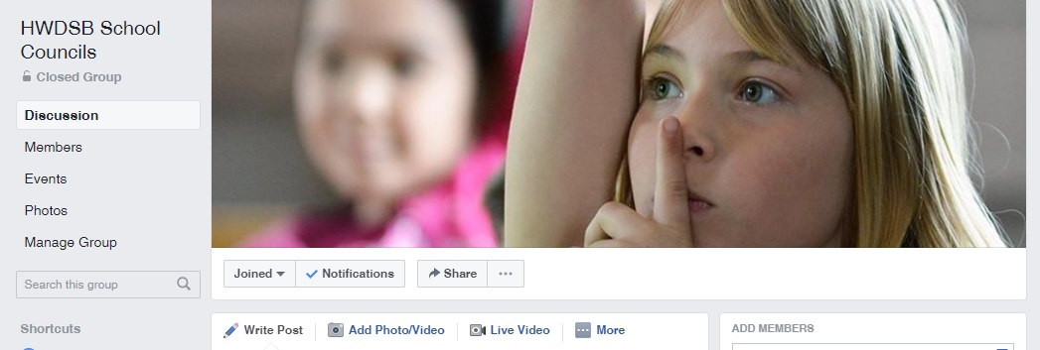
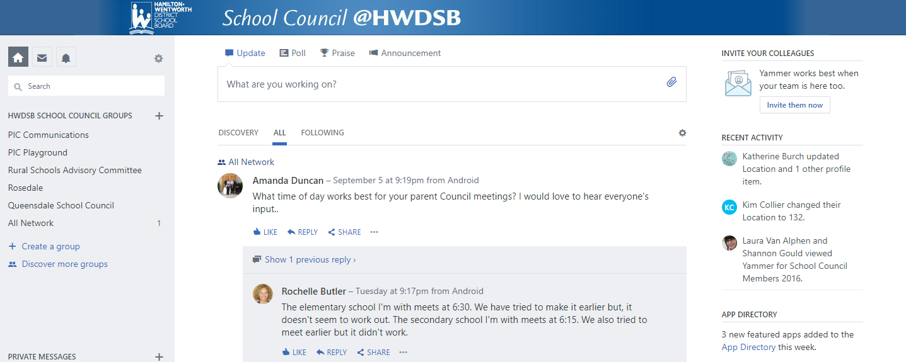
Council/Council Communication: Social Media
Facebook Page
HWDSB School Councils
Contact Group for invite
Yammer Network
School Council
Contact PIC for invitation

Slide 9
Chair & the Principal
Good relationship is key for each School Council Chair and Principal.
Trust, respect and open communication foster effective partnerships and an effective School Council.
Chair and Principal need an effective way to communicate outside of regular meetings, such as email etc.
This may also involve establishing a procedure for urgent issues.

Slide 10
Thank you for your work on behalf of the children
For information or support, please email PIC@hwdsb.on.ca

