Slide 1
Fundraising
School Council Sub-Committee

Slide 2
Learning Goals
  Understand Fundraising Guidelines
  Understand some ways to support student achievement through fundraising
  Understand Ministry allocated funds and available grants

Slide 3
Fundraising
Although not the mandate of school council, some councils may decide to include fundraising as one of their priorities
Fundraising activities may be conducted as long as these are in accordance with board policies and guidelines and the funds raised are used for their intended purpose
Councils should outline in their bylaws how they will determine fundraising priorities
Fundraising efforts must be reported to the community in June as part of the School Council Report to the School Community

Slide 4
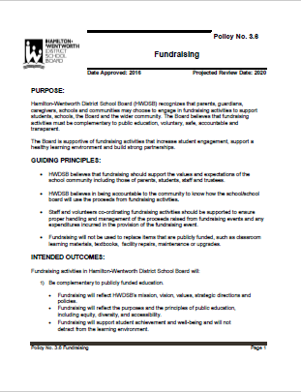
Fundraising
When Fundraising
HWDSB Fundraising Policy
Have a clear purpose in mind
Communicate purpose
Only use funds for this purpose

Slide 5
Use of Funds
Your School Council Also Receives
$500
Each School Year from the Ministry of Education
Many councils use this money to cover the cost of:
  providing information for parents
  child minding
  translation services
  guest speakers, parent event, etc.
The $500 is deposited into the school-level budget in the fall

Slide 6
Parents Reaching Out Grants
Parents Reaching Out (PRO) Grants are offered by the Ministry of Education annually and are applied for by visiting:
http://www.edu.gov.on.ca/eng/parents/reaching.HTML
Ontario's PRO Grants are designed to support parents in identifying barriers to engagement in their own community and to find local solutions to involve more parents in support of student achievement and well-being.
You are eligible for up to $1,000 each year!

Slide 7
Remember…
School councils are not permitted to have their own bank account
School councils must follow HWDSB guidelines
School councils must inform the community about what the funds will be used for
School councils are regulated by the HWDSB School Generated Funds Procedures

Slide 8

Procedures for School Generated Funds
The Roles and Responsibilities of the Principal and the School Council Chair are outlined on pages 8-11 of the HWDSB School Generated Funds document
Information specific to school councils can be found on pages 49-51

Slide 9
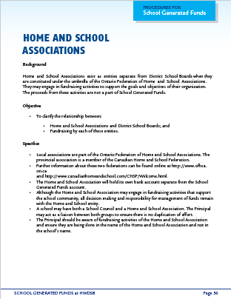
Home and School Associations
It is important to note that there are differences regarding the fundraising efforts of your Home and School Association
Refer to pg. 56 of the HWDSB School Generated Funds document for details

Slide 10

Fundraising Example: Outdoor Design Projects
For any school improvement project, work with your Principal to receive all required approvals.
Here are some fundraising guidelines from the Outdoor Design Manual:
Schools must identify how the design and construction of the project will be funded prior to receiving approval from Facilities Management
Funding must be in place and available prior to the commencement of procurement for each associated phase

Slide 11
Thank you for your work on behalf of the children
For information or support, please email PIC@hwdsb.on.ca

