Slide 1
The News Report
How to write an awesome
news report
on your literacy test

Slide 2
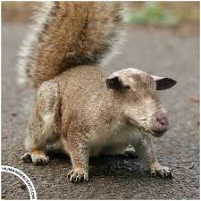
Steps to Writing an Awesome News Report
Read the headline and look at the picture provided.
NEW SPECIES DISCOVERED

Slide 3
Steps to Writing an Awesome News Report
2. Brainstorm what an article with this image and headline COULD BE about.
NEW SPIECES DISCOVERED

Slide 4
Steps to Writing an Awesome News Report
3. Prepare your 5 Ws
(who, what, where, when, why)
NEW SPECIES DISCOVERED
Who-
What-
Where-
When-
Why-

Slide 5
Steps to Writing an Awesome News Report
4. Put the 5Ws into one sentence. This first sentence will be a complete paragraph.
______________________
______________________
______________________
______________________

Slide 6
Steps to Writing an Awesome News Report
5. Write many short paragraphs to further explain details about the who, what and why.
YOU MUST FOCUS ON ONE
MAIN EVENT.
Example ideas:

Slide 7
Steps to Writing an Awesome News Report
6. Include two quotations.
Who could these be from?
Examples:

Slide 8
Steps to Writing an Awesome News Report
7. Fill the space making up more relevant facts (no opinion, no storytelling) in short paragraphs.

Slide 9
Steps to Writing an Awesome News Report
8. Review your report so to make sure you have used only facts and no opinions, your language is clear and you used quotation marks around a quote.
Bye-bye!

Slide 10
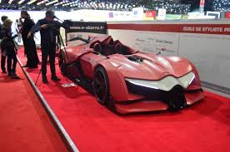
In your groups, identify 5Ws for these images
“Auto class works at the Indy”

Slide 11

In your groups, identify 5Ws for these images
“Students open a new Chill Spot”

Slide 12
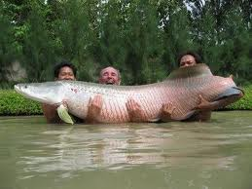
What could an article with this image and headline be about?
Local Fisherman Make Catch of the Day

Slide 13
Working with your group, make up the 5Ws for this image and headline.
Who-
What-
Where-
When-
Why-

Slide 14
Trade 5Ws with another group and turn their 5Ws into a one sentence lead.

Slide 15
Let’s look at an example
Read through the “Car wash a success” article
Write the answers to the following questions on your sheet.
  Identify the who? what? where? when?
  Identify the quotations / interviews
  How many sentences is each paragraph?
  Underline anywhere that you see an opinion.
  How does the author use quotation marks around the quotes?

Slide 16
Practice Writing Leads
Turn to the page titled, OSSLT Practise: Write a Lead for each news report headline.
Let’s do it!

Slide 17
On your own…
Now show us what you’ve got.
Write your own News Report using all of the skills and strategies you’ve learned today.

