Slide 1
What do you say when you are comforting a grammar ‘nazi’?
A: There, Their, They're

Slide 2
When do we use there, their, or they’re?
There is used when referring to a place: “The bookstore is over there.
Their means something belongs to a group of people: “Their house is blue.”
They’re is a shortened form of “They are”: “They are going home.”

Slide 3
Which is it: there, their or they’re?
Which is correct?
I am going there after school.
Their coming with me.
They’re hats are on the bench.
Their cars are parked outside.

Slide 4
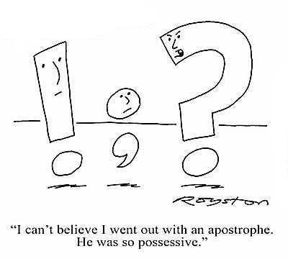
An apostrophe ‘ means a) possession- that something belongs to someone: “Jon’s phone” or “Anmol’s hat”

Slide 5
An apostrophe also means two words have been contracted, shortened into ONE
They’re= They are
There’s= There is
Don’t= Do not
Jon’s going home= Jon is going home

Slide 6
Which sentences use apostrophes correctly?
1.He’s going to Annas house.
2. There having fun.
3. Schools out for the summer.
4. They’re at the movies’.
5. Ravs basketball is on the floor.

Slide 7
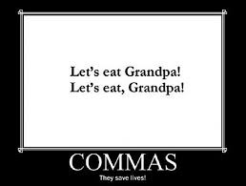

Slide 8
Commas go around “extra” information
Commas go where a pause is needed, after or before a clause
1. Ally, the girl in the first row, is having a potluck dinner tonight.
2. Potlucks, dinners where everyone brings something to eat, are lots of fun.
3. Some cooks, who enjoy making complicated recipes, bring homemade foods like bread or curries.
When cooking for others, you should find out if anyone is vegetarian.
Vegetarians are fine eating only salad, because they don’t want to impose on their hosts.

Slide 9
Commas go after transition words
Commas go in between items in a list.
First, we are reviewing grammar.
Next we will look at the series of paragraphs.
As a final thought we will talk about feeling prepared.
The night before the test you should review your notes, go to bed early, and get a good night’s sleep.
In the morning you should get up early eat a good breakfast and arrive at school with plenty of time.

Slide 10
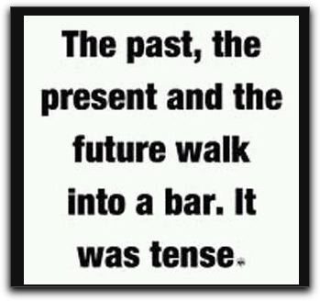
The literacy test is hard for some students even though they passed it.
Match your verb tenses! Don’t switch tenses from past to present!

Slide 11
(1)The Writers’ Guild is a group of writers from the Hamilton area who meet to share their writing. (2) When the club was formed, it includes mostly older people who enjoyed writing for fun. (3)Now, the Writers’ Guild has members from all age groups, who help each other write with interesting perspectives.
Which of the sentences needs revision?

Slide 12
Which verb tenses are used correctly?
The people at the movies enjoy eating popcorn, to relax in comfortable chairs, and lose themselves in the story on the screen.
The people at the movies enjoy eating popcorn, relaxing in comfortable chairs, and losing themselves in the story on the screen.

Slide 13
Quotations are used when someone is speaking. Put END punctuation INSIDE the quotation marks.
If there is no end punctuation at the end of the first bit of speech, do not capitalize the next bit of speech.
“When are you leaving?” Sara asked.
“When are you leaving?” Sara asked. “We will go after you.”
(if there is END punctuation in the first part of the speech, put the next section in capitals)
“After you leave,” Sara said, “we will go, too.”
*note the comma here after said- it is outside the quotation marks and there is no capital as the sentence continues on from before the name tag. (Sara said)

