Slide 1
O.S.S.L.T.
Ontario Secondary School Literacy Test

Slide 2
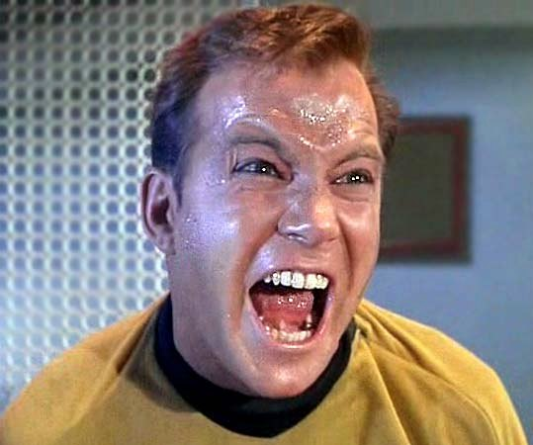
STRESS! STRESS!

Slide 3
What Do I Need To Know?
Thursday March 30 2017 - ALL MORNING
You will be writing the test homeroom classrooms, unless you have a non-traditional classroom or an IEP and have been provided with an alternate setting.
Make sure that you check which room YOU will be writing in.

Slide 4
Make sure that you arrive at school in plenty of time to get to your locker and to your assigned room by 8:20. There is no extra time provided if you’re late.
Passing the OSSLT or OLC4O is a graduation requirement to get your diploma.
It does NOT count for marks toward your English class

Slide 5
You need to bring a pencil and black or blue pen. You can use pencil, but pen is recommended. (You may also use a highlighter on the test itself).
You will be writing two booklets, each taking 75 minutes. You will be given a break in between the booklets. (Snacks will be provided on the break.)

Slide 6
You will be provided with a 2 Question Booklets and 2 Answer Booklets.
You are only able to write 1 booklet during each 75 minute session.
If you finish early, take the time to review your work.
After completing the 2nd session you will complete an informational survey. This is not evaluated.

Slide 7
You will NOT be able to have any electronics (cell phone, IPod etc.) with you, so leave them at home or in your locker.
You must stay for the entire time, even if you are finished.
IF YOU ARE AWAY ON THE DAY OF THE TEST, YOU WILL HAVE TO WRITE IT NEXT YEAR. (Don’t be away if you can at all help it!)

Slide 8
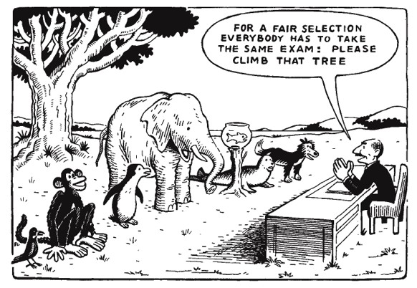
What If I Have An IEP?
There are lots of supports available for you depending on what your IEP covers

Slide 9
How Is It Marked?
Students are successful or unsuccessful
Students must achieve a score of 300 points (70%) to pass
Most AHS students who are unsuccessful are within 5-20 points!

Slide 10
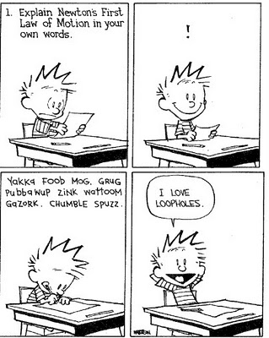

Slide 11
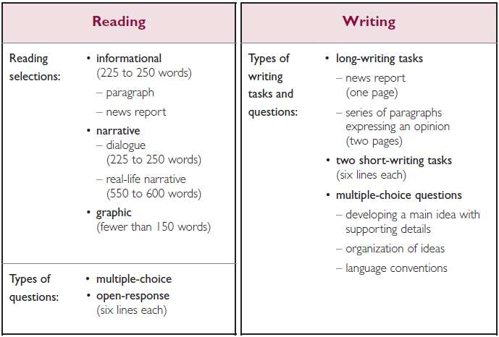
What Does It Involve?

Slide 12
Reading
Reading
3 styles:
Narrative/Dialogue: tells a story
Information/News: provides information
Graphic: visuals, diagrams, charts
3 questions:
Direct
What you see is what you get
Indirect
Reading between the lines
Personal Connections
Relating to your own experiences
Blue Jacket Example

Slide 13
Reading Strategies
look at the title, headings, captions and pictures
think about what you already know about the topic
think about what experiences you have had with the topic
read the questions FIRST
talk to yourself (in your head! - “O.K. it’s asking WHY people like cats” etc.)
picture things in your head – imagine you are watching a movie

Slide 14
Multiple Choice Tips
eliminate the “wrong” multiple choice answers
don’t get frustrated if you have to go back and look at the text – this is expected
skim and scan the selection and use your underlined or highlighted words
GUESS if you don’t know

Slide 15
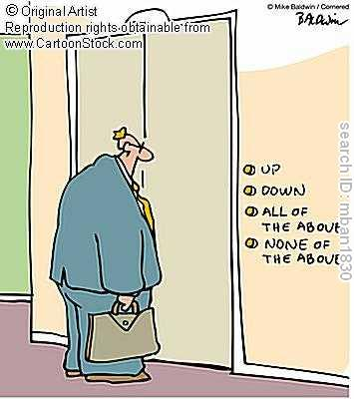

Slide 16
Writing
News Report
Write about the headline and picture
Make it up but no funny business
Include the 5Ws + H and quotations
Write using the 3rd person (no “I think”)
Use multiple small paragraphs
Fill up the space provided

Slide 19
Writing: Series of Paragraphs Expressing an Opinion
Take a position on the question and clearly state it – no sitting on the fence!
Plan to write 5 paragraphs
Introduction: thesis + 3 main reasons
3 body paragraphs: reason with minimum 2 examples/proofs
Conclusion: summarize and restate thesis and 3 reasons

Slide 20
Possible Questions
Should all car manufacturers be required to produce hybrid vehicles?
Is graffiti art or is it a crime?
Should extra-curricular activities be compulsory for high school students?
Should young people be forced to stay in school under the government's new Learning to 18 Policy?
Should students be required to study a foreign language at high school?
Should volunteer hours be mandatory in high school?

Slide 21
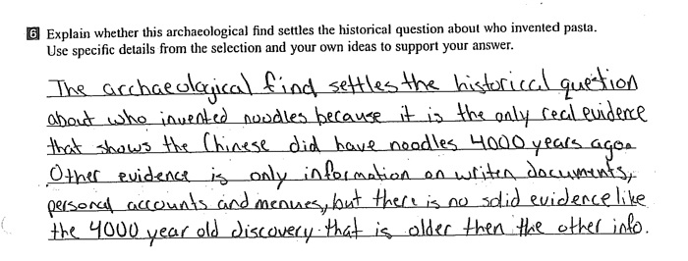
Writing: Short Answers
Short Answers
6 lines provided
Have 1 main idea with supporting details

Slide 22
Writing: Conventions
There will be multiple choice sections asking you to identify proper sentences, vocabulary and errors
Spelling and grammar count, but clarity is the most important.
Use proper capitals, punctuation and sentences. No bullet points.

Slide 23
Actual OSSLT pieces, their scores and the rubrics used to evaluate will be posted on our school website!

Slide 24
Want More Help?
1. Google or Youtube ‘OSSLT Help’
2. Go to EQAO.com and look under OSSLT Student Resources
3. Play Read! Write! Rock! at readwriterock.com
4. Talk to your teachers

Slide 25
Exit Strategy…
Please take out your cell phones and complete the following short, exit survey and have a chance to win a $20 gift certificate!
tinyurl.com/jmna94m

Slide 26
GOOD LUCK!

