Slide 1
YOUR HEALTH ACTION TEAM PRESENTS…
FLAVOURED TOBACCO AND E-CIGARETTE

Slide 2
Freeze the Industry is a youth-led campaign that raises awareness about ways the tobacco industry makes their products appealing to young people.
The tobacco industry creates and markets products that are addictive and appealing to youth which can cause illness and death.
“Big Tobacco” does this by adding flavours to their current tobacco products and introducing new and innovative products targeting younger, under-educated new paying customers
Freeze the Industry: is calling for a ban on all flavoured tobacco products in Canada!

Slide 3
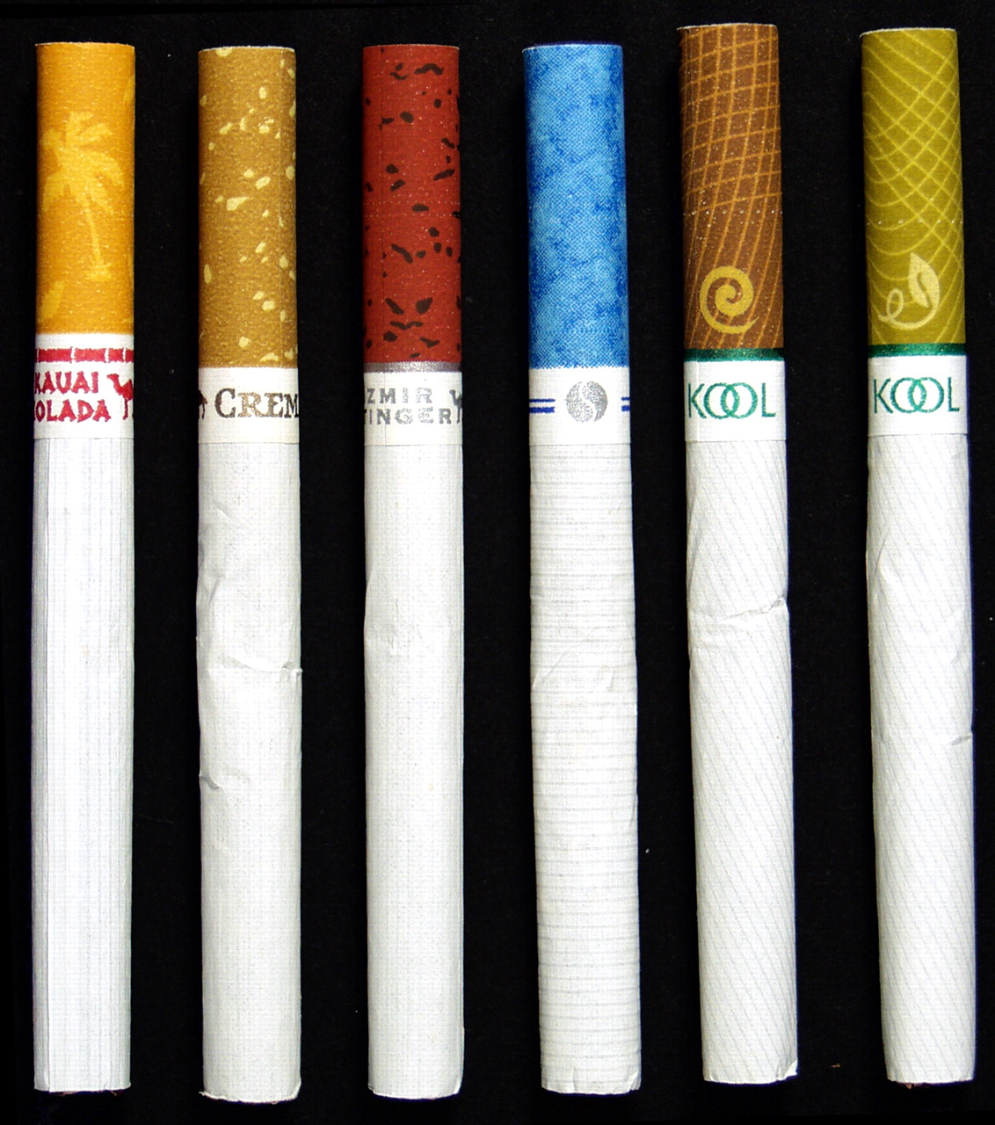
We need a law that bans ALL flavours
in ALL tobacco products
in Canada
[1]http://www.camh.ca/en/hospital/health_information/a_z_mental_health_and_addiction_information/tobacco/Pages/about_tobacco.aspx

Slide 4
BECAUSE:
Product Marketing and Packaging: The tobacco industry uses creative marketing strategies like adding flavours and introducing new products and brands that appeal to youth and young adults to entice them to try tobacco.
Health: Tobacco use is still the number one cause of preventable disease and death in Canada!
Killing more than 37,000 people every year[1] or 101 people a day.
In Ontario, that is: 13,000 every year or 36 PEOPLE a day!
Tobacco Industry Exploits Legislative Loopholes: The tobacco industry consistently finds ways to exploit loopholes in laws designed to protect youth from trying and becoming addicted to tobacco products.
Youth Prevention: We can help prevent youth from experimenting with tobacco and becoming addicted to tobacco industry products, by first banning flavours.

Slide 5
SH*T TOBACCO INDUSTRY EXECUTIVES SAY
https://www.youtube.com/watch?v=XHyheOH_yaM

Slide 6
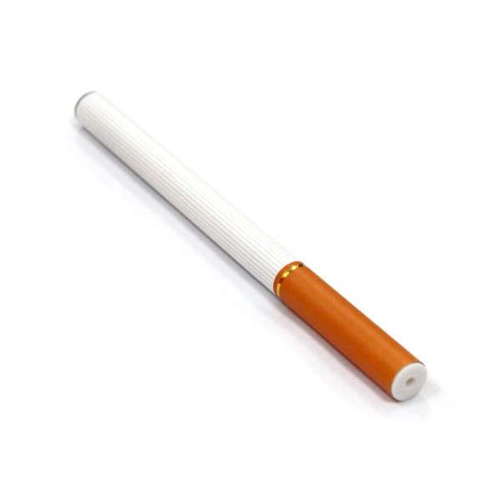
WHAT IS FLAVOURED TOBACCO?
The tobacco industry adds enjoyable flavours like:
Cherry, Mocha and Cotton Candy
to their products which appeals to, recruits and
Hooks OUR YOUTH
into using their deadly products.
Inventing new tobacco products which are seen as: SAFE COOL and LEGAL
are all forms of innovative marketing that appeals
to OUR youth.

Slide 7
WHAT ABOUT: SHISHA ?
Shisha is a glass-bottomed water pipe in which can contain fruit-flavoured tobacco is covered with foil and roasted with charcoal. The tobacco smoke passes through a water chamber and is inhaled deeply and slowly; the fruit-flavoured tobacco tastes smooth and smells sweet, enthusiasts say, making it an enjoyable, relaxing and pleasant experience!
IMAGINE?
Legislation of these kinds of products is hard due to the fact that not all hookah and shisha products contain tobacco. This means in order to enforce a law one must test to confirm the tobacco contents .

Slide 8
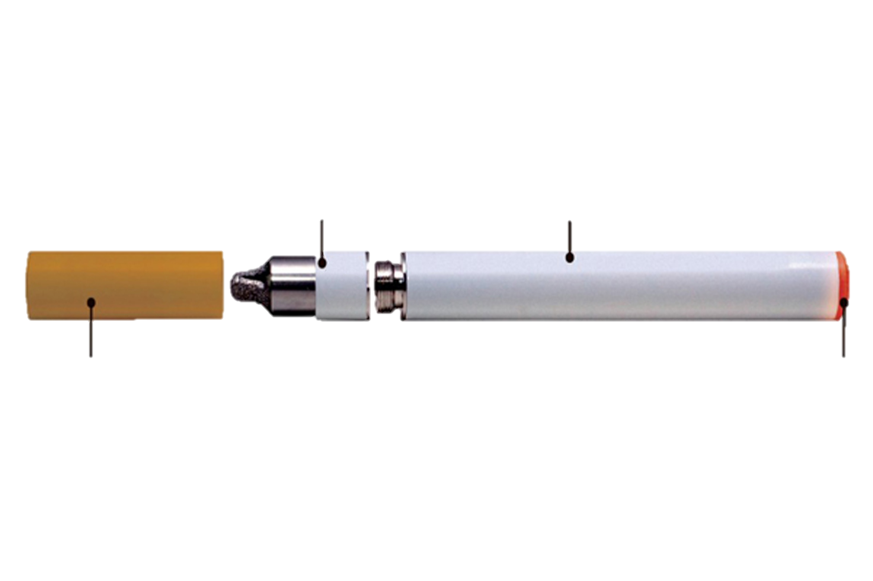
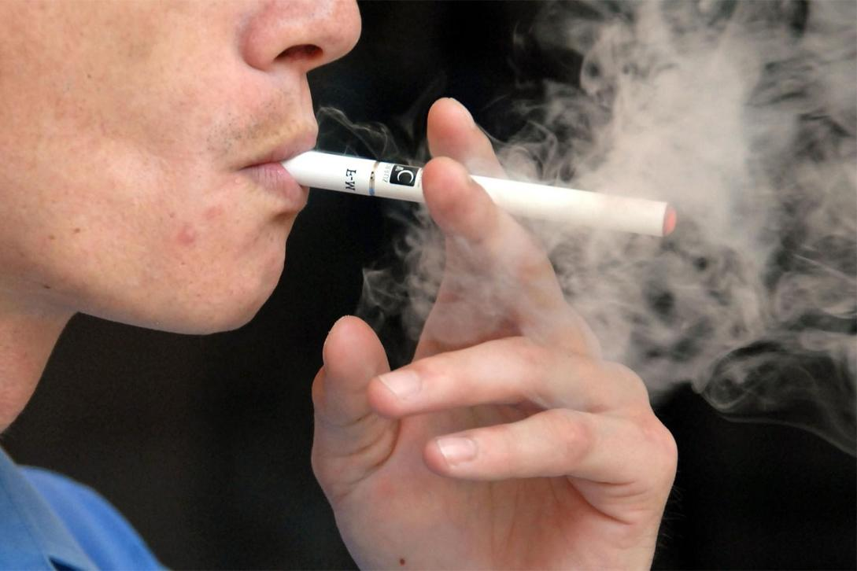
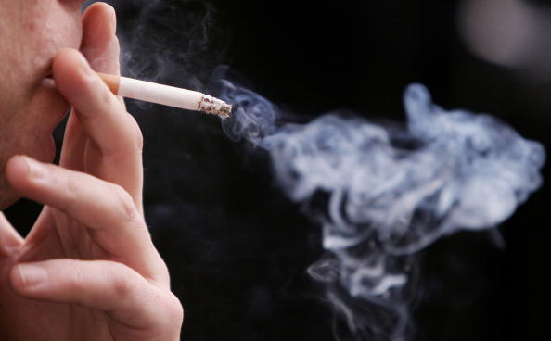
WHAT ARE E-CIGARETTES?
Electronic Cigarettes release vapor instead of smoke
Atomizer heats up and vaporizes
e liquid
Battery
E liquid is inserted into Cartridge
LED light

Slide 9
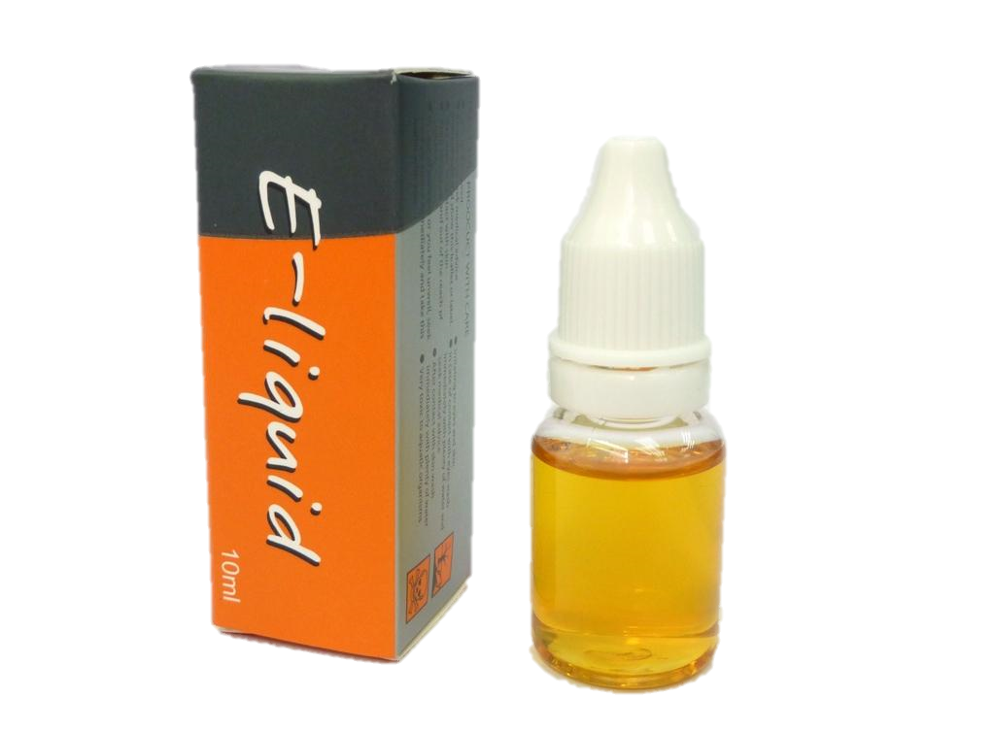
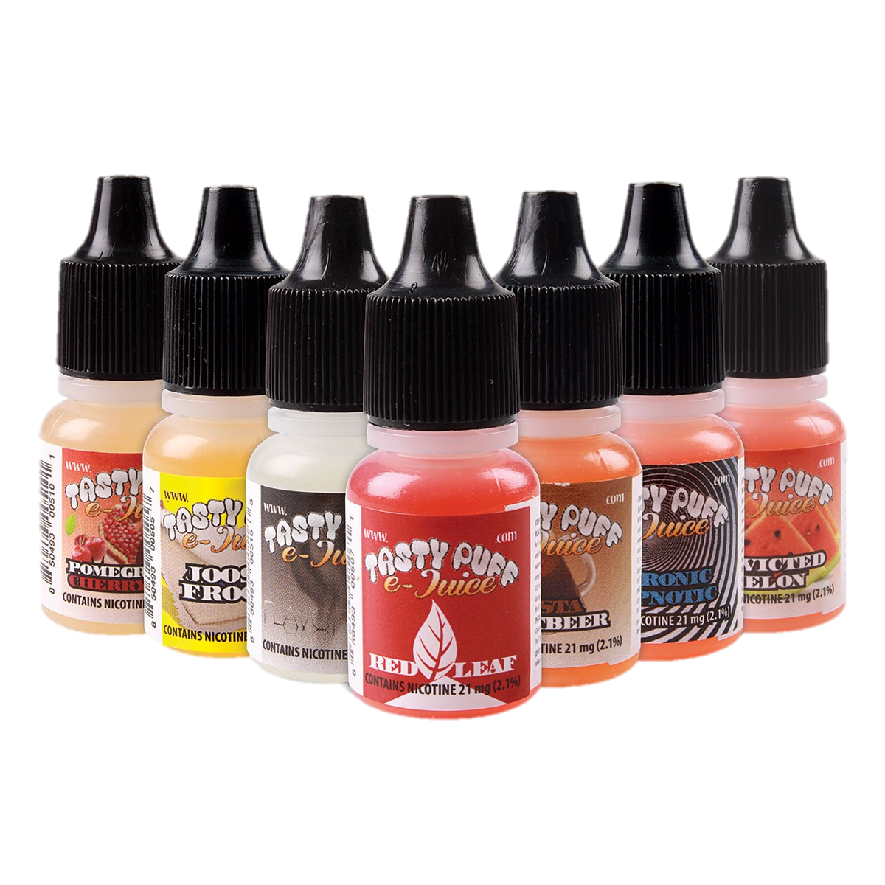
WHY DO WE CARE
E liquid with nicotine content is illegal to import into Canada due to it’s non-registrant status with health Canada. Nicotine based cartridges are illegally sourced into the country
E- liquid or E- juice is the flavouring and the source of an E - cigarette’s addictive appeal
-propylene glycol
-glycerin
-nicotine (some)
-flavorings
Flavors can include root beer, bubblegum, Creamsicle, peanut butter, &
an assortments of fruity flavors.
These liquids are hazardous to your health. There are multiple documented cases of harm to children under 5 years of age. A drop, when ingested or absorbed by skin, can cause vomiting, seizures and death.

Slide 10
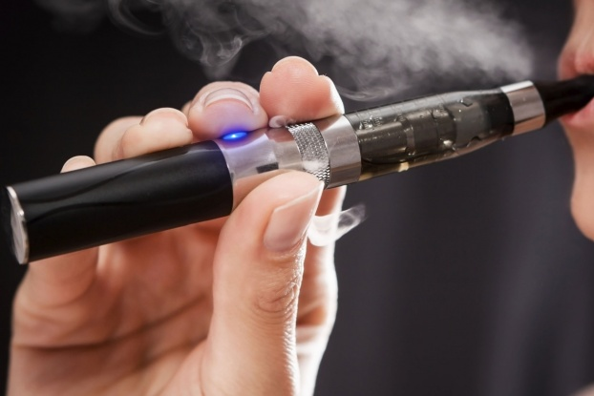
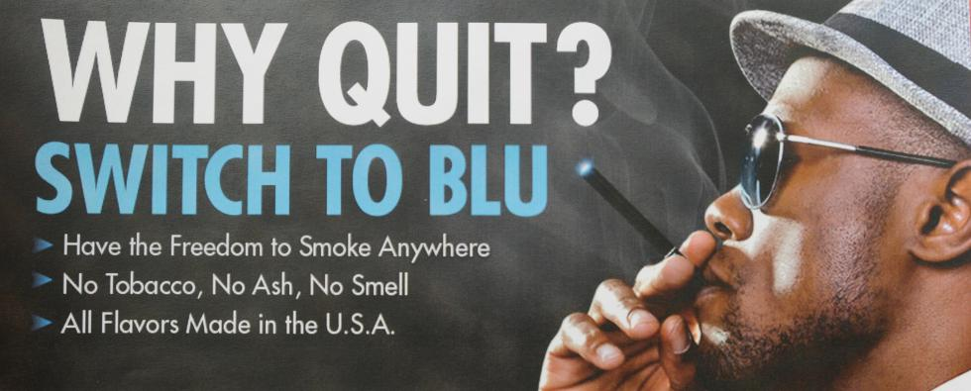
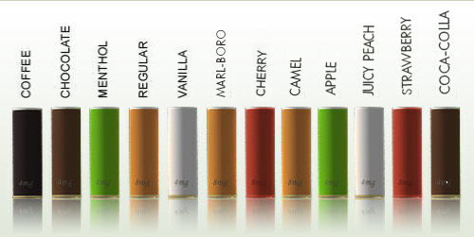
HOOKED OR NOT
What’s the appeal?
Colourful
Flavourful
New Technology
Freely able to smoke anywhere
Just because they have no tobacco, tar or smoke doesn’t mean they aren’t addictive!
The ‘e- liquid’ or flavour still contains NICOTINE;
the same substance that makes standard cigarettes addictive.
These e liquids have nicotine levels that range from 1.8 % to 10 %

Slide 11
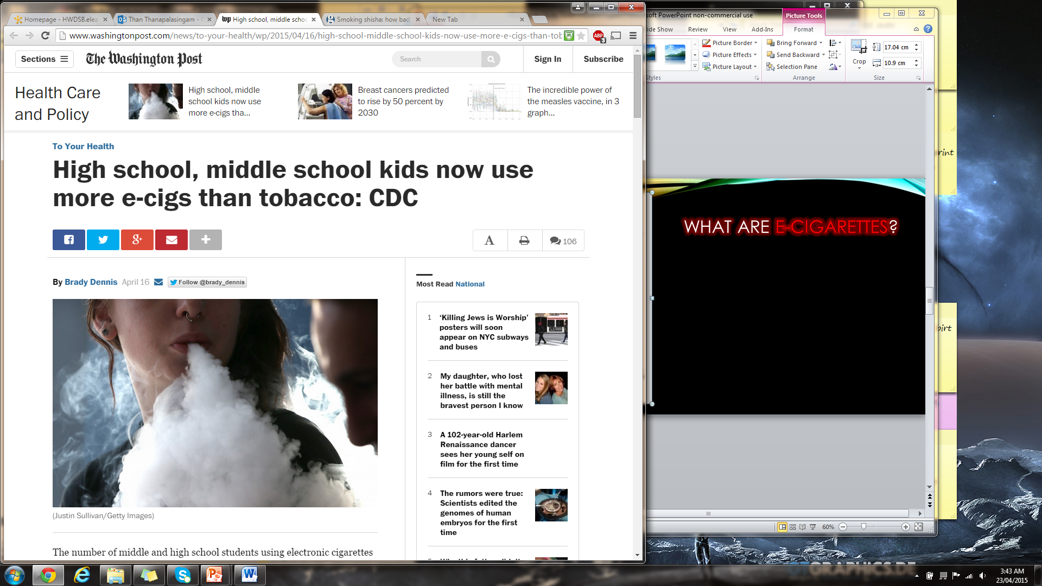
BREAKING NEWS
E-cigarettes are appealing to youth. A Canadian study found that 18% of high school student non-tobacco smokers had tried e-cigarettes and another 31% are interested in trying them.³
*figures reflect U.S. Data

Slide 12
Safety concerns have arisen with these unregulated products, given that the long-term health impact of inhaling propylene, nitrosamines or vegetable glycol and the effects of second-hand exposure are unknown.
Researchers and public health experts are concerned that there is potential for e-cigarettes to be a gateway to tobacco use and nicotine addiction. Public Health experts are concerned about emerging research showing that e-cigarettes could renormalize and undermine tobacco control and smoking cessation efforts!

Slide 13
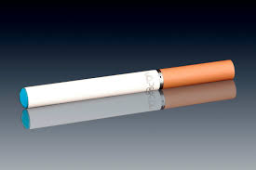
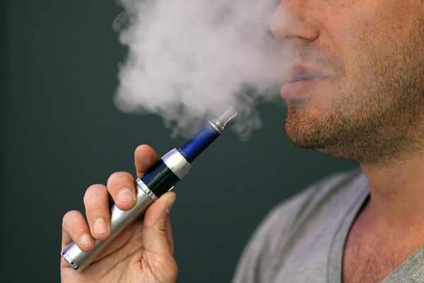
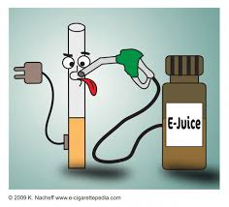
PERCEIVED BENEFITS VS. FACTS
Fewer carcinogens than Traditional cigarettes
Less damage to lungs than Traditional cigarettes*
Allows users to quit Traditional cigarettes*
Functions similarly to the nicotine patch
Less harmful to second hand smokers
*although there are, at this time, no conclusive long-term studies with large enough sample sizes to support these ideas

Slide 14
CONSEQUENCES
Greater Nicotine content than cigarettes ……..
Dry skin
Dry mouth
Rash/burning sensation on face
Itchiness
Puffy/dry eyes
Caffeine sensitivity
Minor blood/nose issues
Cancer
Addiction
*although there is insufficient conclusive scientific data at this time & research is on going and could support these early findings

Slide 15
POLICIES AND BY-LAWS
FEDERAL
PROVINCIAL
(starting 2016)
No regulations classifying E-cigarettes the same as traditional cigarettes
No advertising restrictions
Import of nicotine containing cartridges is banned
Advertising of nicotine containing cartridges are banned
Advertising Any positive health claims of E-cigarettes is banned
E-cigs are banned where cigarettes are banned (2017)
No one under 19 can purchase (Jan 2016)
No flavourings allowed (starting 2016), except MENTHOL is (2017)
Harsh penalties for those selling to underage individuals
* ONLY if BILL 45 receives Royal Assent and is passed!

Slide 16
TOMORROW
Locally:
We Desire…
an E-Free Environment
&
a Zero Tolerance Policy

Slide 17
HELP US MAKE THIS HAPPEN
Teach our Ancaster Community about the product and its implications
Lobby your MPP to ensure that this does not become an easily accessible product
Sign our advocacy letter
Keep our school e-free with a 0 tolerance policy
Host an assembly so that all our kids are on the same page
Be a Leader; communicate with our Board, our desire and initiatives
Support our upcoming BE -E -FREE campaign

