Slide 1
Gr. 9 Option Sheet Information Night
January 12, 2017

Slide 2
Agenda
Welcome message from administration
Review of Westmount program
Structure of high school
Graduation requirements
Grade 9 Courses
Course Levels
Post-secondary considerations
Next steps for parents and students
Questions

Slide 3
Structure of High School
Generally a 4 year program
Two semesters per year
Four credits per semester
Most students take 8 courses per year (many take a spare or two in senior grades)

Slide 4
Graduation Requirements
30 credits
18 compulsory courses
12 elective courses
40 hours of community involvement
Provincial grade 10 literacy test (OSSLT)

Slide 5
Of the 12 elective credits:
- two selections in grade 9
40 hours of community involvement:
- students can begin their community hours during the summer after grade 8 graduation
- be sure to check that the activity is eligible
-http://www.hwdsb.on.ca/secondary/graduation- information/diploma-requirements/cih/students/
The OSSLT – grade 10 literacy test:
- All Ontario students write the same day in grade 10

Slide 6
Required Courses by Grade
Grade 9 | Grade 10 | Grade 11 | Grade 12
English | English | English | English
Math | Math | Math
Science | Science
Geography | History
French | Civics /Careers
Physical Ed.
(Arts)
G1, G2, G3 | G1, G2, G3 | G1, G2, G3 | G1, G2, G3

Slide 7
Other compulsory credits
Students must earn ONE credit from EACH of these three groups during any grade of high school:
G1. an additional English, additional French, a third language, social science or humanities, Canadian and world studies, guidance and career education, or co-op course
G2. an additional health and physical education, additional arts, additional French, business, or co-op course
G3. a senior science, technological education, additional French, computer studies, or co-op course

Slide 8
Elective Courses
Most students will choose two elective courses. It is recommended that students take the compulsory arts credit (any course code starting with “A”) before the end of grade 10.
ADA1O1 – Dramatic Arts*
AMU1O1B – Music (Instrumental) Beginner*
AMU1O1 – Music (Instrumental) Experienced*
AMV1O1 – Vocal Music*
AVI1O1 – Visual Arts*
BTT1O1 – Information Technology in Business (G2)
HIF1O1 – Exploring Family Studies (G1)
TIJ1O1 – Exploring Technologies (G3)
PPL1O1T – Healthy Active Living Training (Co-ed)
LVLBD1 – Latin (G1)
GLS1O1 – Foundations of Inquiry (G1)
* If 2 “arts” credits are taken, the first course will be the compulsory arts credit, and the second course will count as a G2 compulsory credit.

Slide 9
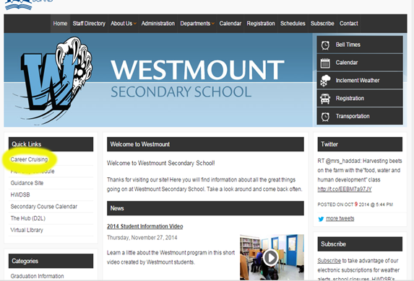
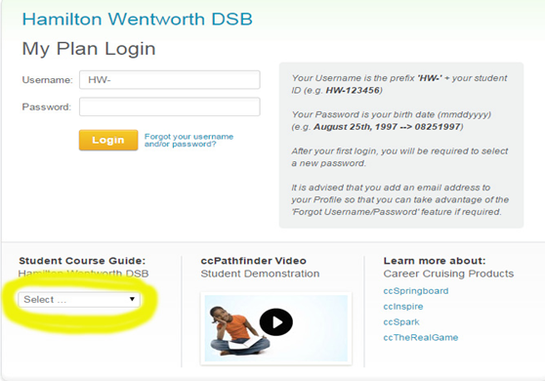
Detailed Course Descriptions
Links to course descriptions can be found on the Westmount website.
http://www.hwdsb.on.ca/westmount/

Slide 10
Levels of Grade 9 Compulsory Courses
English | Enriched, Academic or Applied
Math | Enriched, Academic or Applied
Geography | Enriched, Academic or Applied
French | Academic or Applied
Science | Enriched, Academic or Applied or Applied Package
Phys. Ed. | Female, Male or Fitness Training (Co-ed)

Slide 11
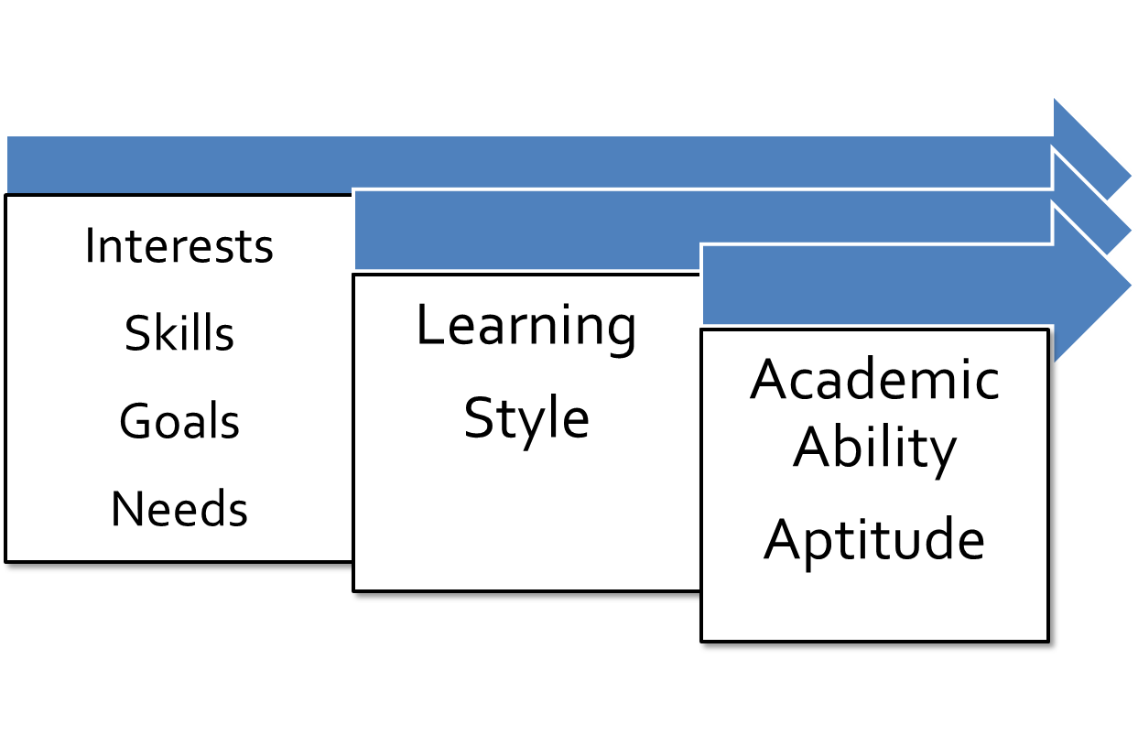
How should I choose my course level?

Slide 12
Levels of Courses
Open
Expectations appropriate for all students
Includes all grade 9 and 10 elective courses (except classical/international languages = academic)
Applied
Develop knowledge and skills with emphasis on practical applications
Students often are on a pathway to an apprenticeship, college, or work; can be a pathway to university for some programs as long as English is taken at the “academic” level for grades 10 - 12

Slide 13
Levels of Courses
Academic
Focus is on essential concepts as well as emphasis on theory and abstract thinking
Builds a foundation of knowledge for future studies
Often, students are considering university (although all pathways are open)
Enriched
Academic curriculum with further extensions
May be suited for students considering AP programs, those who enjoy inquiry-based learning, or those identified as ‘gifted’ (note: no “enriched” indicator on transcript)

Slide 14
Course Levels – An Example…
Applied English ENG1P1
Read a short story (high interest, low vocabulary)
Write a series of paragraphs
Homework expected, but fewer hours
Academic English ENG1D1
Read and discuss Shakespeare’s Twelfth Night
Write a formal 5 paragraph essay
Homework expected each night
Specific, closed-ended questions
Enriched English ENG1D1E
Read and discuss Shakespeare’s Midsummer Night’s Dream
Write a formal 5 paragraph essay
Emphasis on open-ended questions and creativity
Extended dramatic presentations, class discussions and inquiry-based projects

Slide 15
Sample Timetable
Period | Semester 1 | Semester 2
1 | GLS1O1 Foundations of Inquiry | ENG1D1E Enriched English
2 | MFM1P1 Applied Math | SNC1D1 Academic Science
3 | FSF1D1 Academic French | Lunch
4 | Lunch | AMU1O1 Music
5 | CGC1D1 Academic Geography | PPL1O1F Healthy Active Living

Slide 16
Post-secondary Considerations
In grades 11 and 12, students choose courses based on their destinations after graduation – referred to as their ‘pathway’. The levels of courses change in name from Applied and Academic to College, Mixed, University, and Workplace.
Westmount can prepare students for these pathways:
Apprenticeship
College
University
Work

Slide 17
E-learning options
Geography Academic (CGC1D), Geography Applied (CGC1P)
English Academic (ENG1D)
Math Academic (MPM1D)
Designed for independent learners who are self-starters
Not part of the Westmount program – not self-paced/self-directed (has deadlines & no carryover option)
Teachers are HWDSB teachers, not Westmount teachers
Students will be scheduled into the Learning Commons to work on the elearning course
A good option for students who require flexibility in the day due to other commitments or physical limitations

Slide 18
Next Steps for Parents and Students
Jan. 27, Letter of Intent, and Out-of-Board applications due
Feb 1, Parents/elementary school will be notified if accepted to Westmount
Feb. 8-17 HWDSB students enter options (course selections) online
Having trouble with entering options? Drop-in Help Available
Wed Feb 15, 3:30pm - 4:15pm in the Westmount Learning Commons.

Slide 19
Next Steps for Parents and Students
Spring / Summer Events
May 18 9:00 – 11:00 a.m. (auditorium) – Orientation for all incoming Grade 9 students
Aug 30 Timetable Pickup and Picture Day 10:00am - 12:00pm
Information about upcoming events will be shared via email (email address submitted on Letter of Intent) and on the school website.

Slide 20
Westmount Tours
Still unsure if Westmount is right for you? Want to see what self-pacing and self-direction looks like in a classroom? Book a tour of Westmount.
Student and Parent(s)/Guardian(s)
45 minute walk through of Westmount
Variety of dates available throughout the school year
Book a tour after the presentation
Or email Roberta Haddad, Student Success Teacher to sign up for a date (rlhaddad@hwdsb.on.ca)

Slide 21
Questions?

