Slide 1





SCHOLARSHIPS
finance your education
L E T O P G U I D A N C E
S H O W
Y O U H O W

Slide 2
TYPES OF SCHOLARSHIPS
AUTOMATIC ENTRANCE SCHOLARSHIPS
No application req'd Based on your admission average
SCHOLARSHIP REQ'ING APPLICATION
Usu. has essay component References needed as well
ATHLETIC SCHOLARSHIPS
American universities must write SATs must register with NCAA Eligibility Center

Slide 3
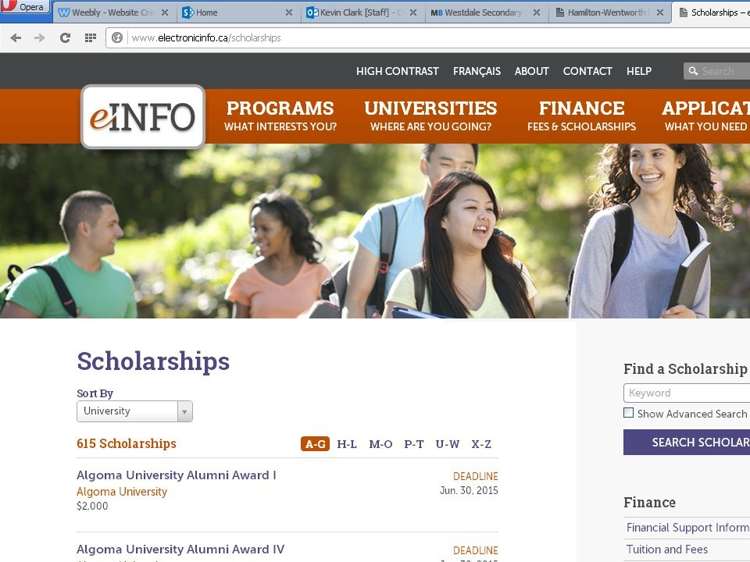

Slide 4
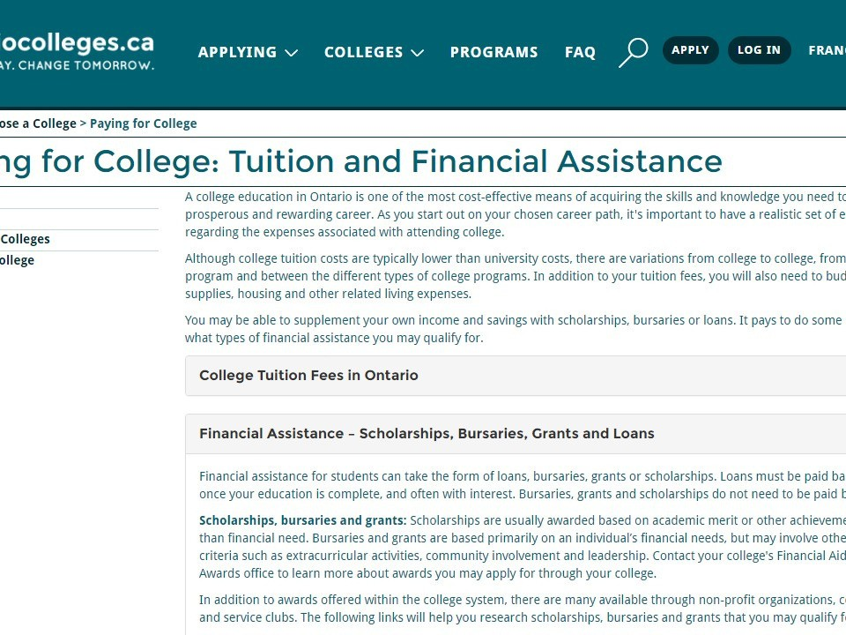

Slide 5
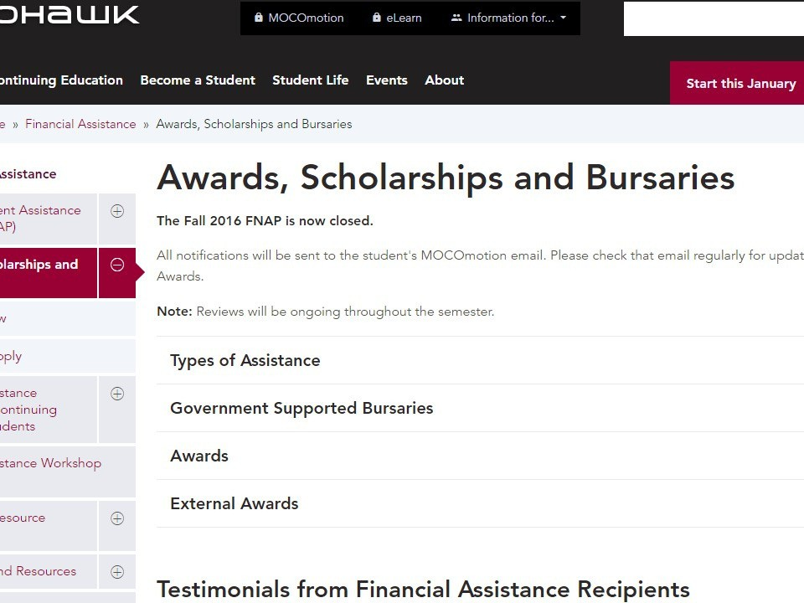

Slide 6

Scholarship Report
In Guidance Office http://seekingscholarships.com/

Slide 7


Slide 8


Slide 9
SCHOLARSHIP REQUIREMENTS
01
Academic achievement Leadership
Community Service
Talent, example: Robotics Team
SCHOLARSHIP APPLICATIONS
Transcripts
Essay from student
Letters of recommendation
School Nomination, example: SCHULICH
02
SCHOLARSHIP WRITING TIPS
Research award
Applications must be perfect - edit! See your guidance counsellor for help
03

Slide 10
OSAP: 2018
new rules

Slide 11
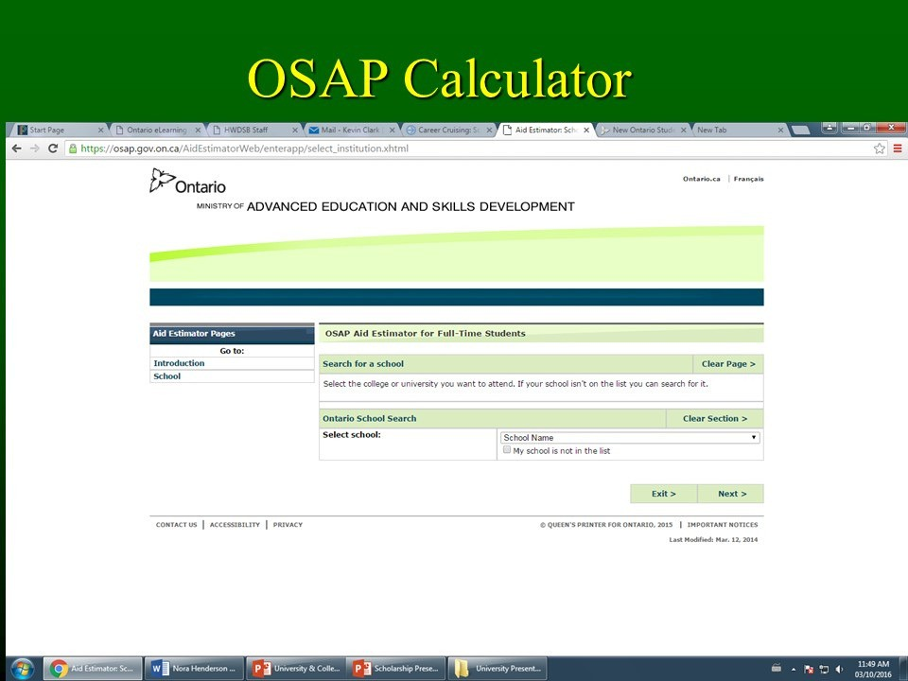

Slide 12
?
$$
!
How much you get depends on: tuition/books/ living expenses
How much money depends on:
family income, size and other factors
For family households making $83,000 to
$130,000 there is more access to interest-free and low cost loans through OSAP.
LINK YOUR OUAC & OCAS APPLICATION TO OSAP APPLICATION
Tuition fees are covered for students whose parents make a combined income of
$50,000/ yr.
Grants for students whose parents make combined income of
$80,000/ yr.

Slide 13
AVAILABLE IN SPRING OF 2018
WWW.ONTARIO.CA/PAGE/HOW- APPLY-OSAP
follow
opguidance
on INSTAGRAM

