Slide 1
Ontario College Online Application
Your future starts here . . .

Slide 2
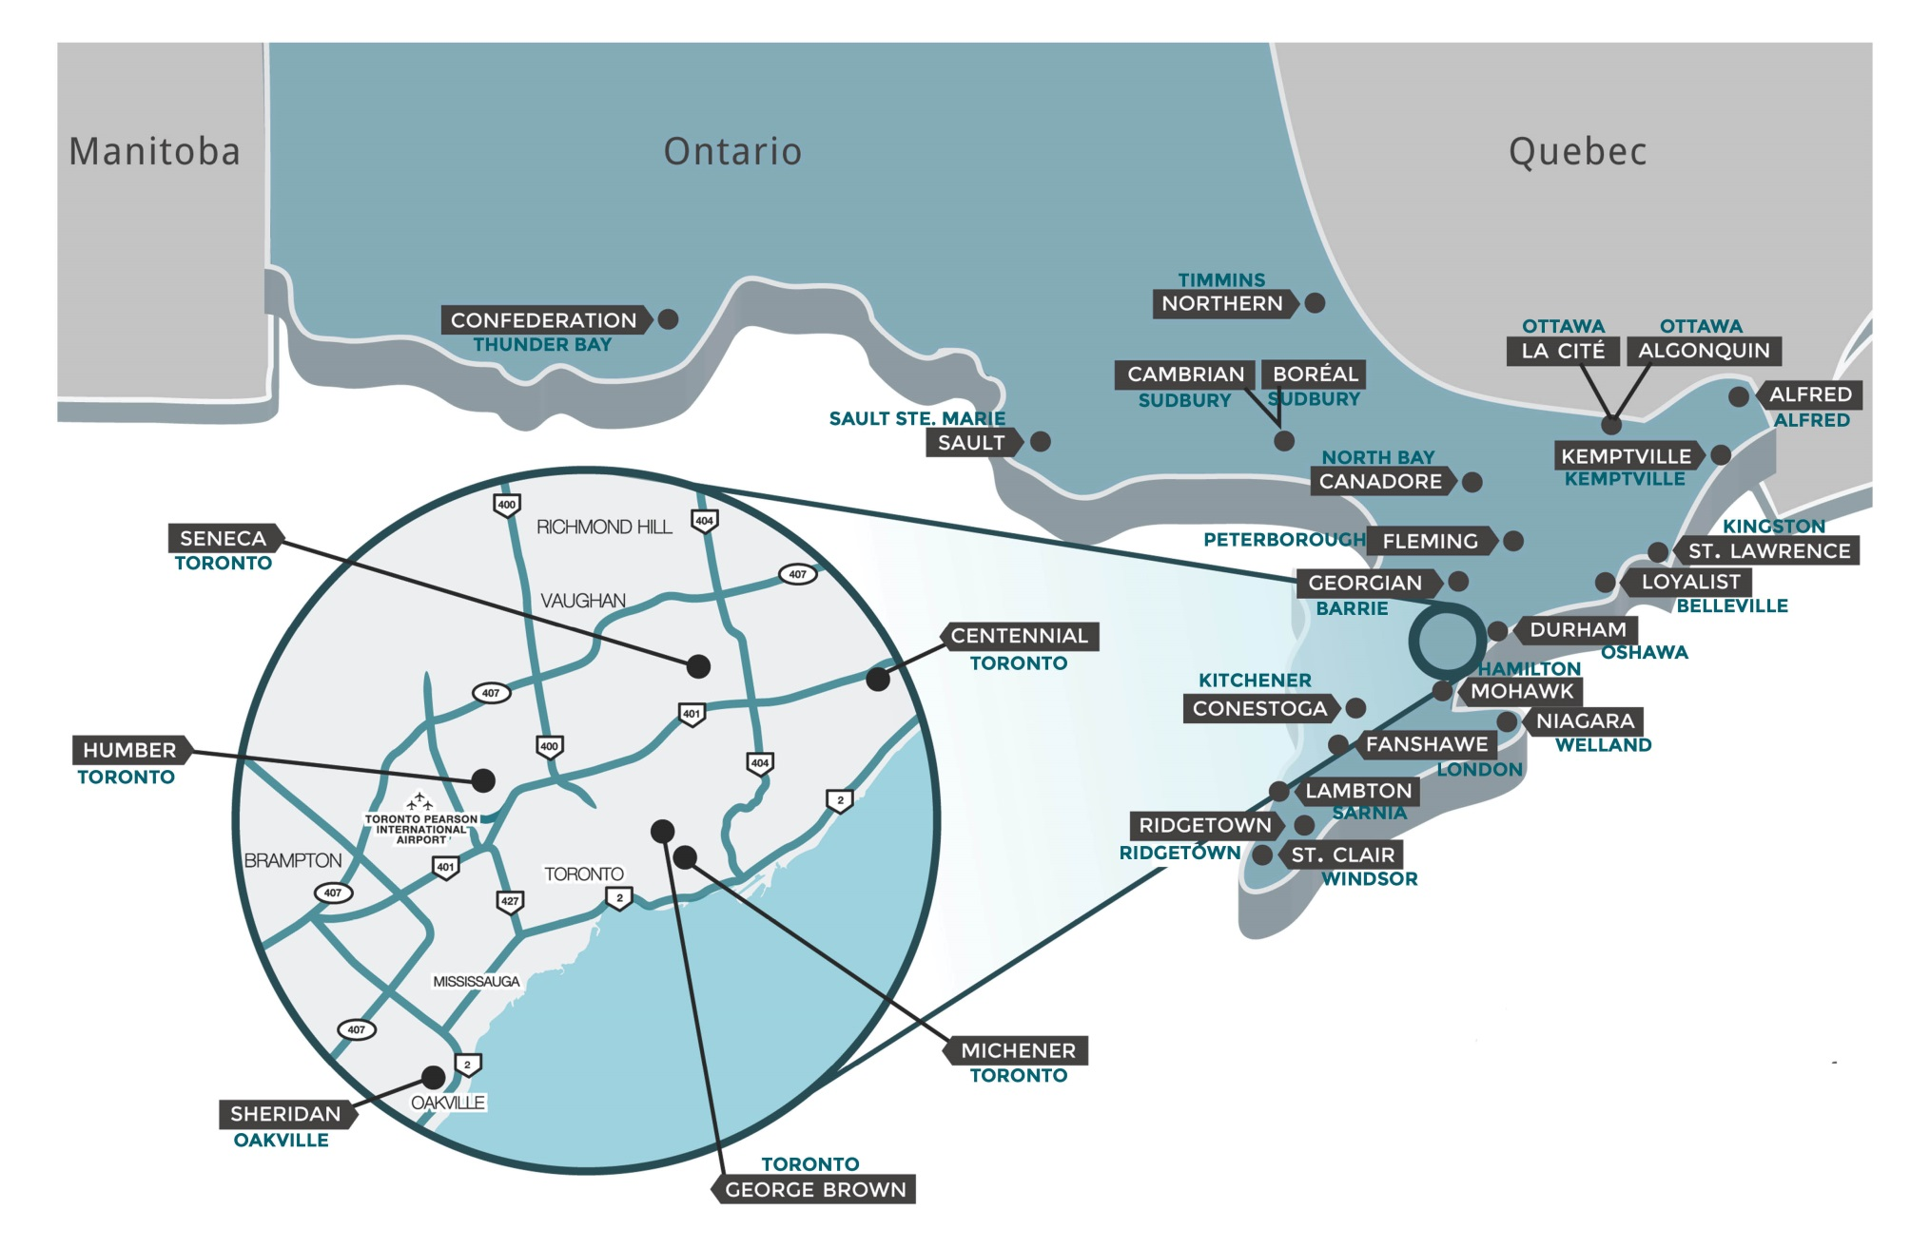
Step 1 – Research colleges and programs
FIND A COLLEGE – view the map

Slide 3
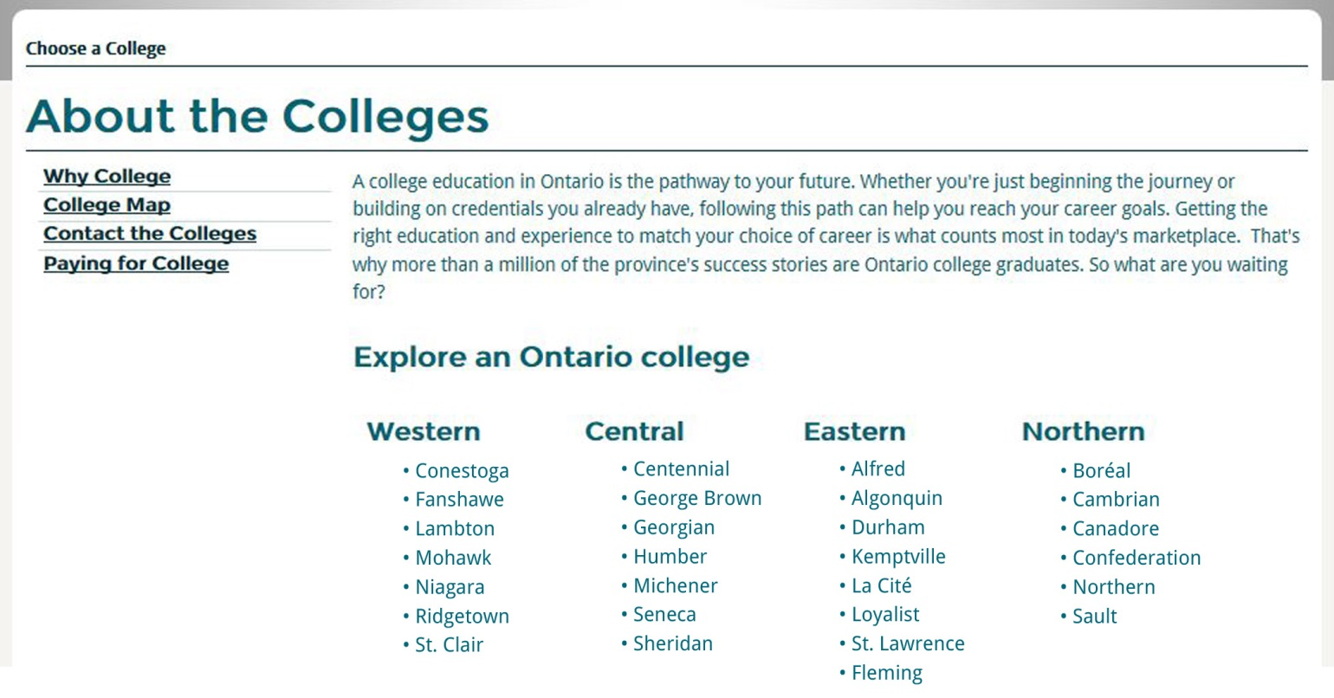
FIND A COLLEGE – link to college websites
Visit ontariocolleges.ca and click on the “Choose a College” button.
Links to individual college websites

Slide 4
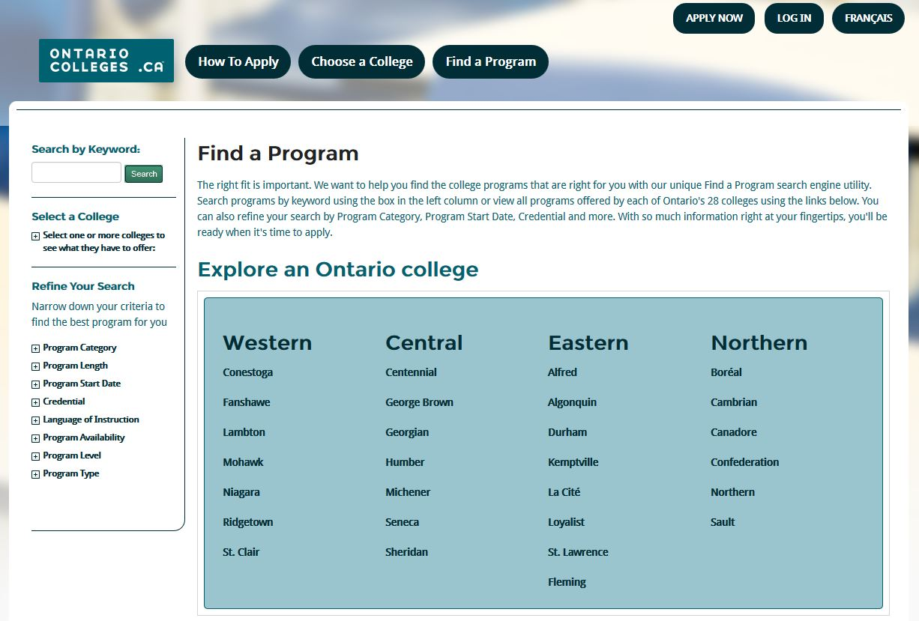
FIND A PROGRAM TOOL
ontariocolleges.ca/find
Search by keyword
Search by a college
Link to college information

Slide 5
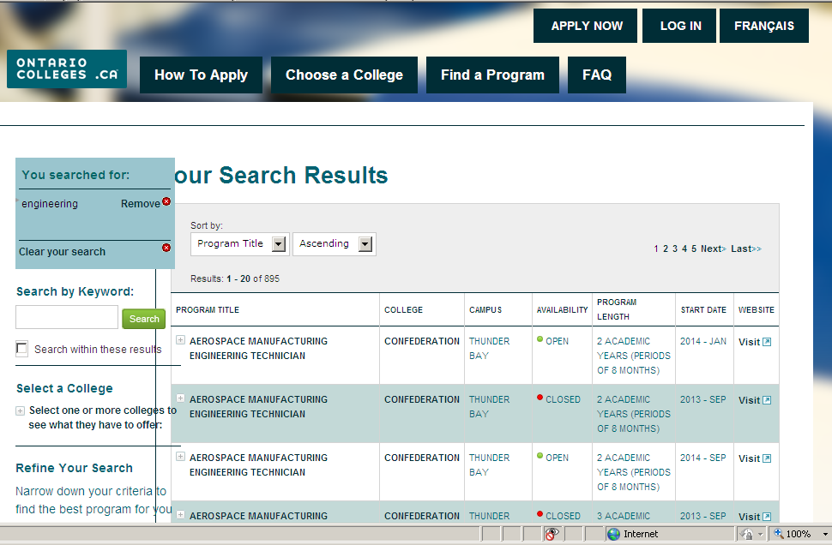

Slide 6
Important Dates
February 1, 2014 – Equal Consideration Date
February 1, 2014 – Earliest Offer Date
May 1, 2014 – Accept Offer Date
June 16, 2014 – Earliest Tuition Fee Payment

Slide 7
Important Info Before You Apply
The application fee is $95 (non-refundable)
An application allows you up to 5 program choices, with no more than 3 at any one college
All program choices must start within the same academic year (August – July)
DO NOT create more than one account
The application works best in the following browsers: Internet Explorer 8+ Firefox 17+ Chrome 23+ Safari 5.1
Check your junk/spam mailboxes if you do not receive emails from ‘myaccount@ontariocolleges.ca’ and add to your safe senders list.

Slide 8
Your ontariocolleges.ca Account
Your ontariocolleges.ca account allows you to:
Apply to any of Ontario’s 28 public colleges
Review and update your college application
Request Ontario high school transcripts (from participating schools) (Note: current high school students have their transcripts sent automatically by their high schools)
Request Ontario college / university transcripts
View and accept offers of admission

Slide 9
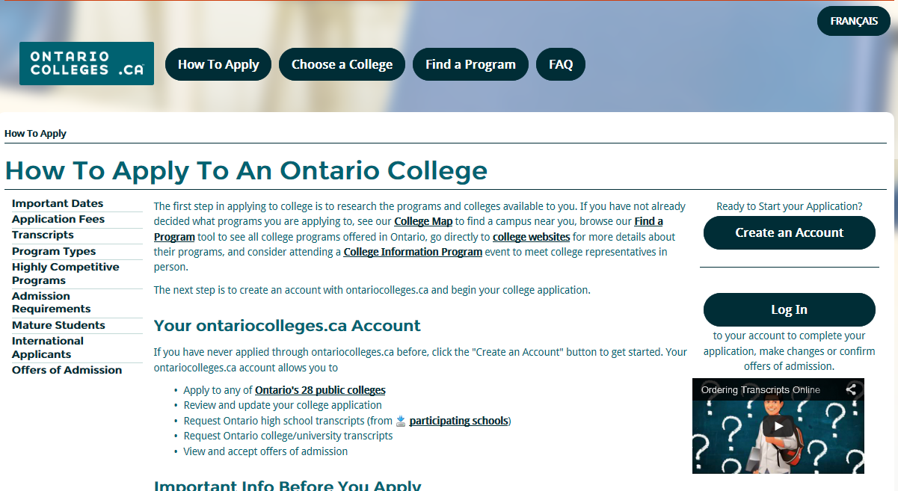
Step 2 – Create an Account
Go to ontariocolleges.ca
New Users: If you have never applied through ontariocolleges.ca before, click the “Create an Account” button
Returning to your application: If you have an existing account, click “Log In”

Slide 10
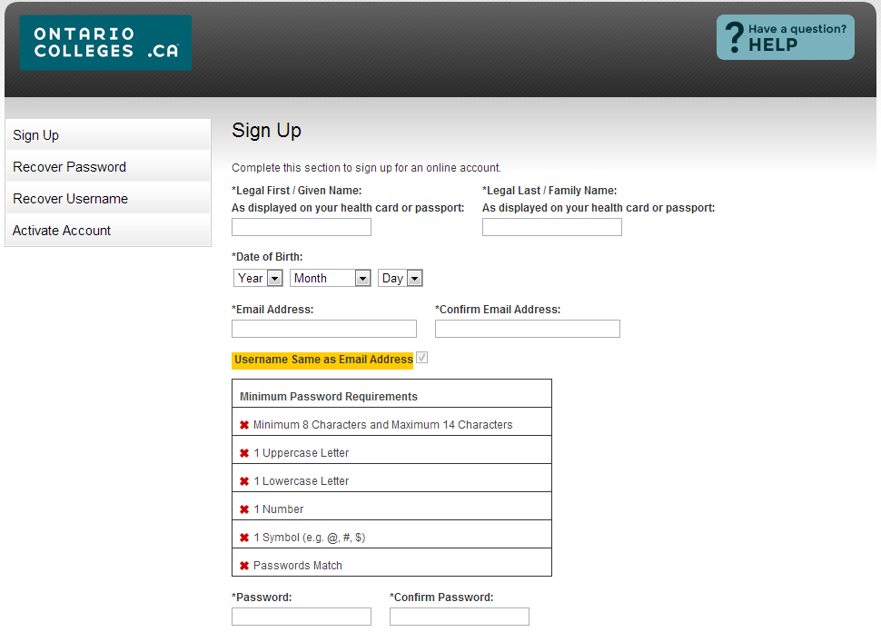
Create an Account
Complete required fields
Password ‘rules’
Passwords that DO NOT meet these requirements will not allow you to login.

Slide 11
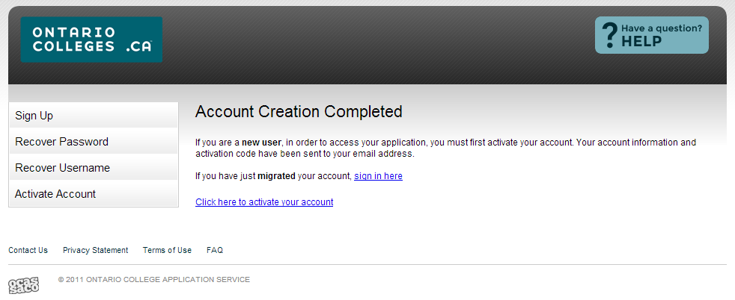
Activate Your Account
! You cannot log in to your account without first activating it
Click the link to activate your account.
An activation email is also sent to the email on file.
You only need to activate your account using one method (screen or email).

Slide 12
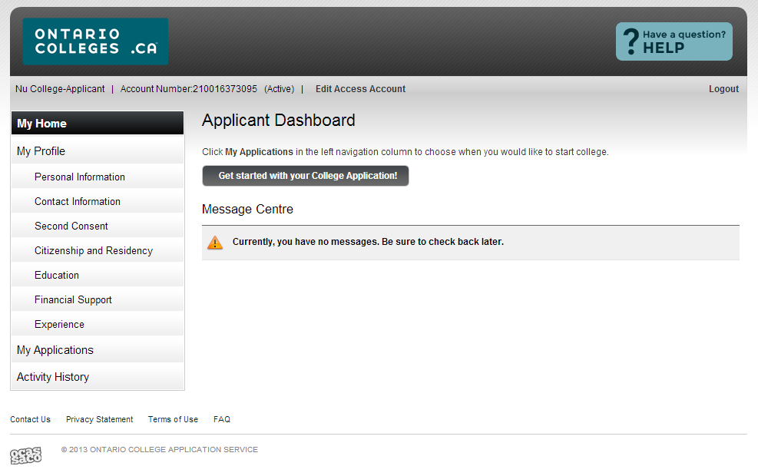
Step 3 – Applicant Home Screen / Dashboard
Start your college application from this screen.
MESSAGE CENTRE: Important information about your application is found here. Check regularly.

Slide 13
MY PROFILE:
A checkmark ( ) will appear after each section is completed.
All sections (even if they do not apply to you) must be completed, in order, when you complete your account the first time.
Click ‘Save’ to continue to the next step.

Slide 14
MY PROFILE:
Personal Information – basic demographic info, including legal name, date of birth, etc.
Contact Information – street address, email address, telephone numbers
Second Consent – authorization to allow another individual access to your account/application (e.g. parent, guidance counselor) (Note: not shared with the colleges)
Citizenship & Residency – Citizenship, residency status in Canada, country of birth
Education – schools attending/attended; marks will be posted to this section
Financial Support – agency sponsorship; this does not include OSAP
Experience – add employment or volunteer experience that relates to your area of study

Slide 15
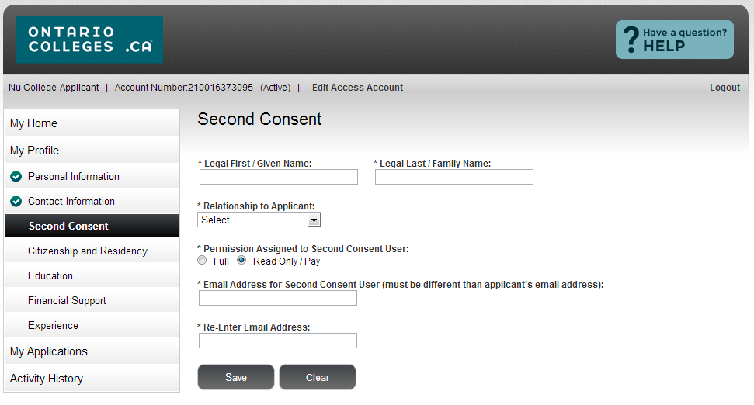
Complete required fields. Click ‘Save’
Full Access – authorized individuals may make payments AND changes to your application information
Read Only/ Pay – authorized individuals may make payments and ONLY VIEW your application information

Slide 16
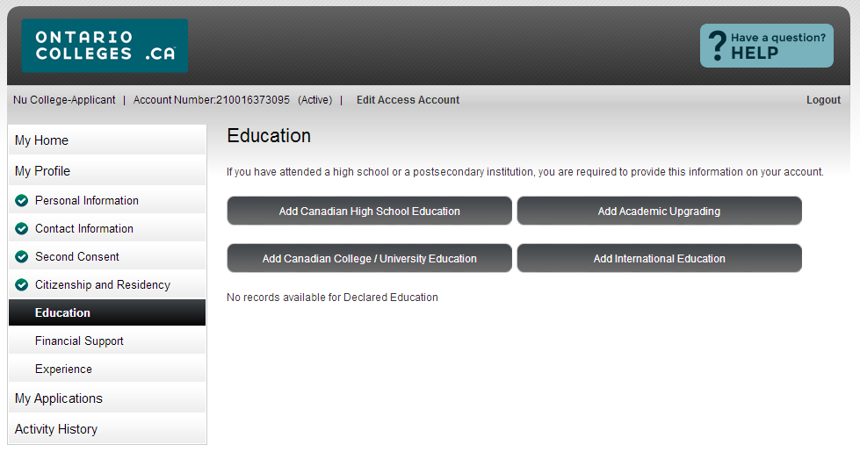
Education
Complete only the sections that apply to your education experience.

Slide 17
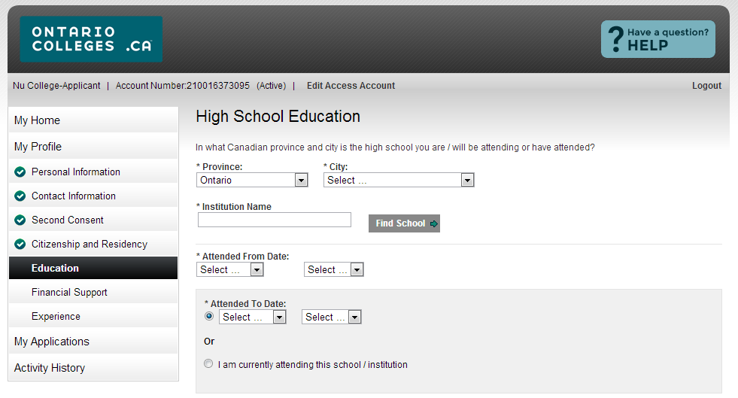
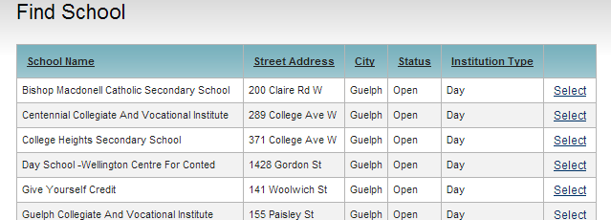
High School Education
Use the drop down menus to complete all fields.
Ontario high school students: use the ‘Find School’ drop down to add your high school.

Slide 18
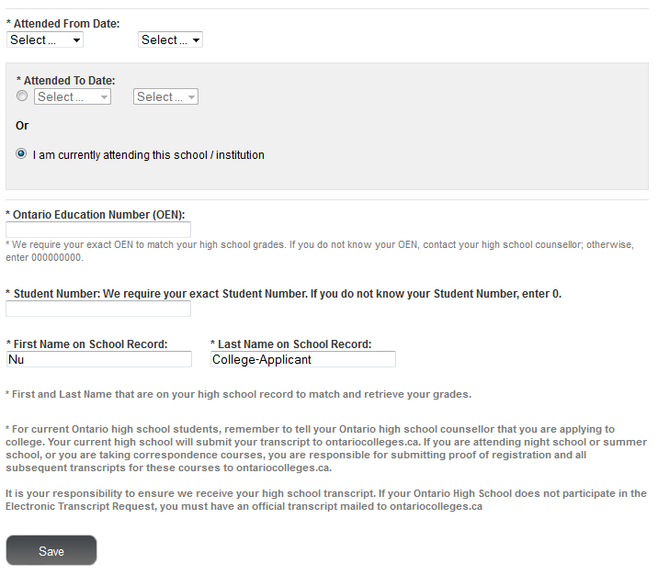
All Applicants – enter the date you began high school
Graduates / Former Students – Enter the date you completed/ left high school
Important for current students
! Current Students – Click the radio button
To allow us to match your grades to your application, your OEN, student number and name (as it appears on your school record) must be accurate.
Click ‘Save’ when done.
CURRENT STUDENTS ONLY
Your high school will automatically forward your grades to ontariocolleges.ca.

Slide 19
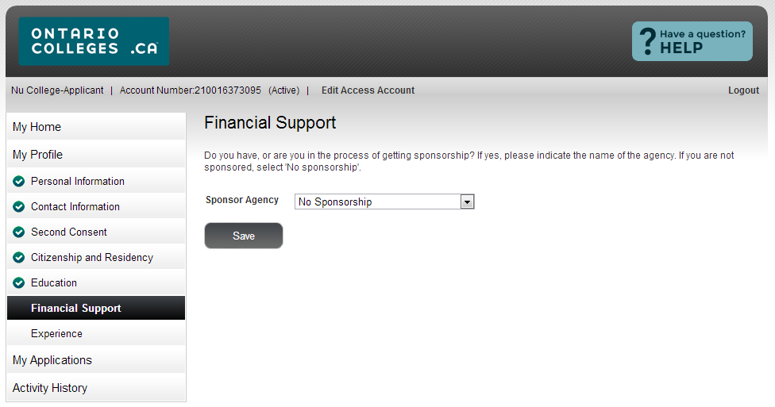
Financial Support
Use the drop down menu to select the agency. Click ‘Save’.
Sponsor Agency – agency that will be paying all or part of your educational or living expenses while at college.
If you are applying for financial assistance (e.g. OSAP, bursary, scholarship, etc.) you are not considered ‘sponsored’ and should select ‘No Sponsorship’.

Slide 20
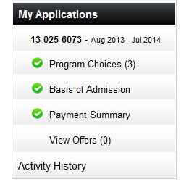
MY APPLICATIONS:
Program Choices – select or update your program choices in this section
Basis of Admission – identify if you are/will be a high school graduate or enrolled in a high school course
Payment Summary – listing of fees requiring payment
ACTIVITY HISTORY:
Summary of application’s day-to-day activities

Slide 21
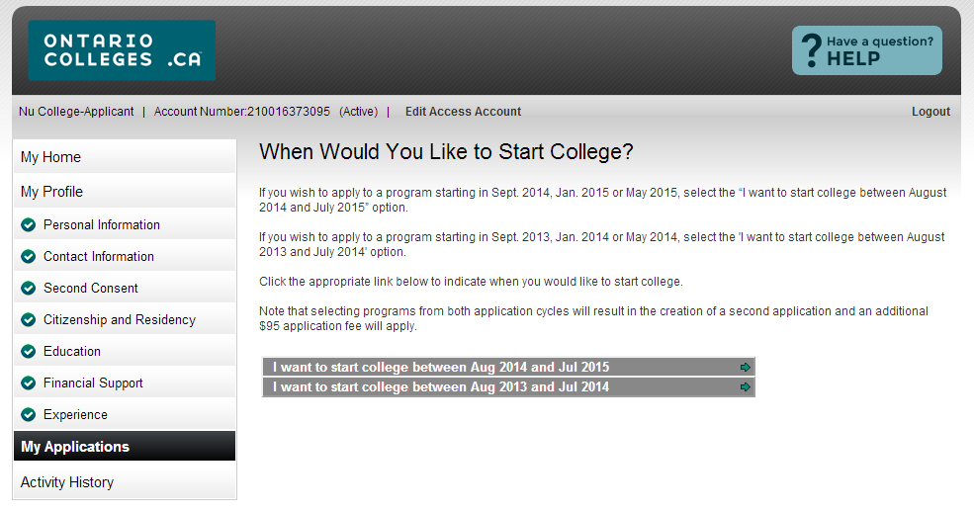
Select Programs
Select the link for the dates you wish to begin your studies.
Programs with start dates in:
• September 2014 • January 2015 • May 2015
Selecting programs from BOTH application cycles will result in two applications and an additional application processing fee.
! Fees paid on duplicate applications are non-refundable.

Slide 22
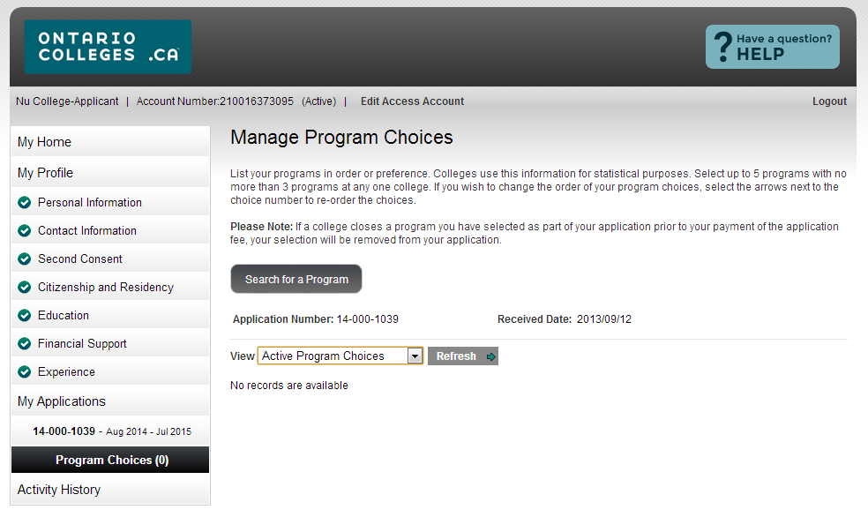
Record your Account Number and Application Number.
Received Date – is the date your application processing fee payment is received and processed.
You may apply to a maximum of FIVE program choices with no more than THREE at any one college.
List your programs in order of preference.
You cannot create additional applications to apply to more programs. (sorry!)

Slide 23
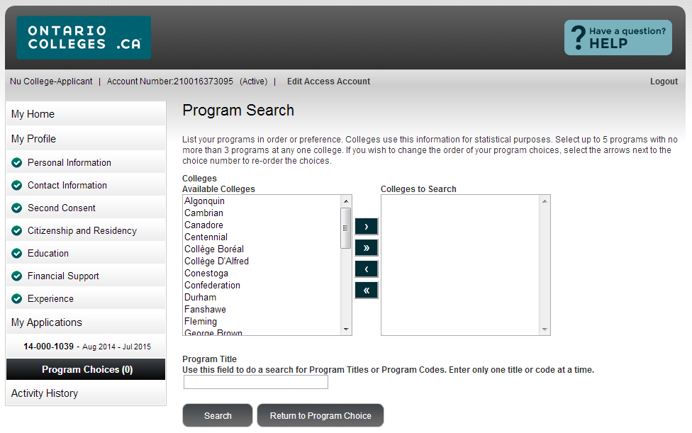
‘>’ – search for programs at ONE college
‘>>’– search for program at ALL colleges

Slide 24
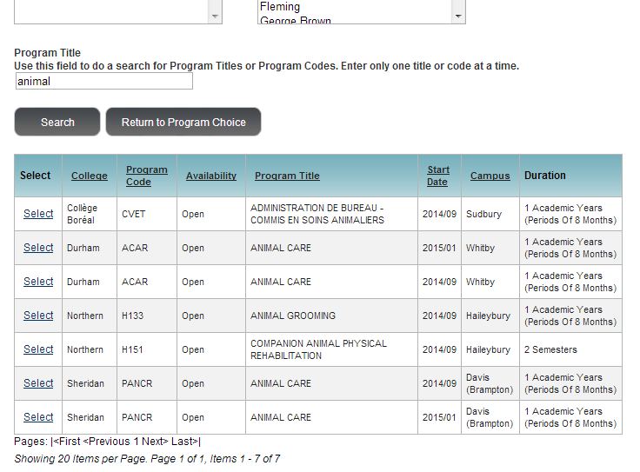
Enter ONE word of the program title or the program code.
Click ‘Search’
Click ‘Select’ to add the program to your application
Make sure you select the correct program start date

Slide 25
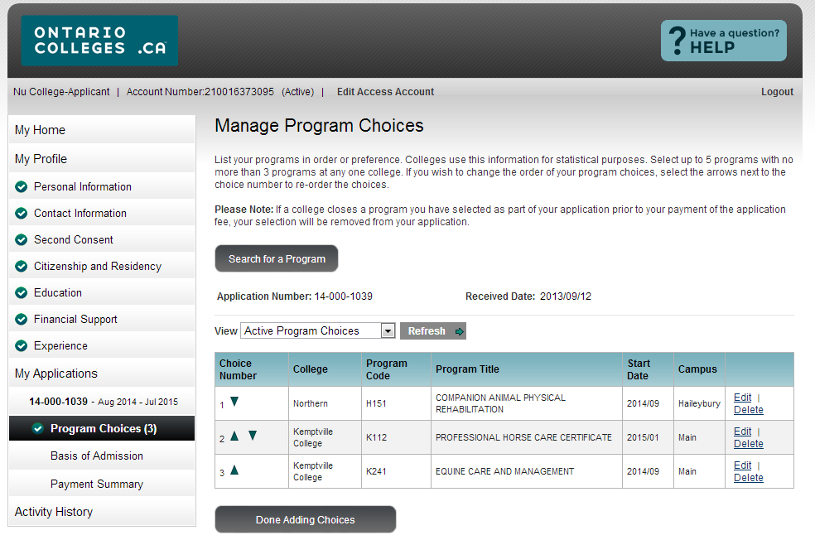
Manage Program Choices
Click ‘Search for a Program ’ to add additional programs
Click ‘Edit’ to change program information OR ‘Delete’ to remove the program from your application.
Use the green arrows to reorder your program choices (if required).
Click ‘Done Adding Choices’ to move to the next step.

Slide 26
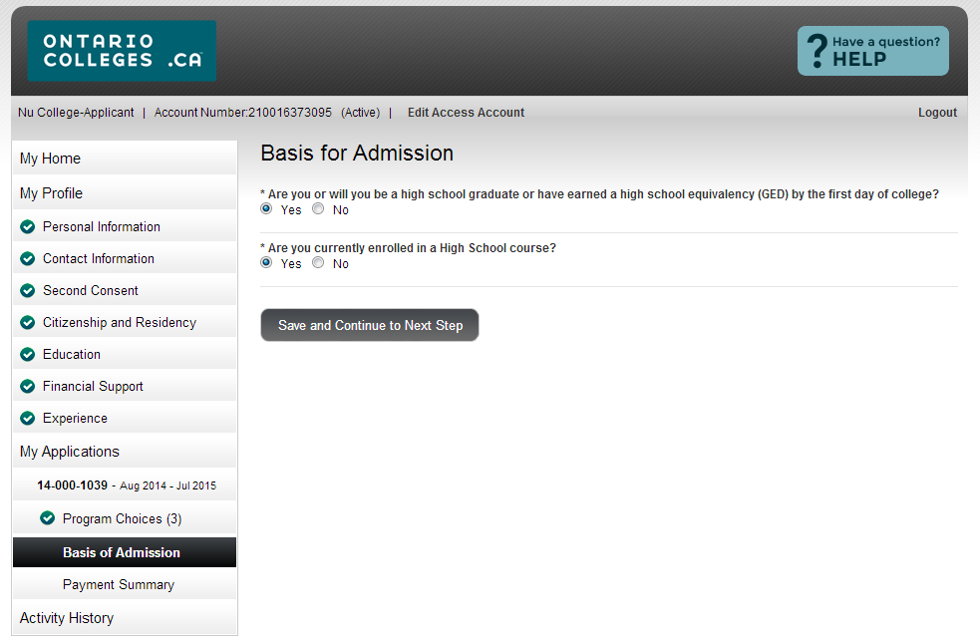
Basis for Admission
Review and answer the questions.
Click ‘Save and Continue to Next Step’ when done.
Current high school students: make sure ‘yes’ is selected for question 2.

Slide 27
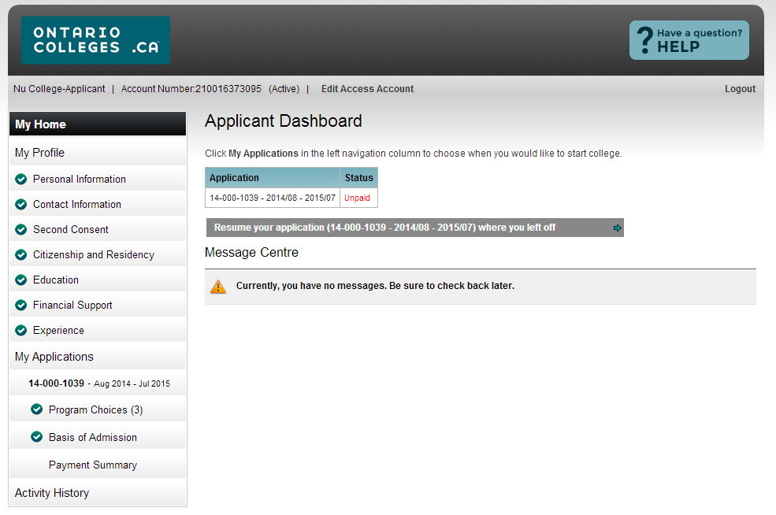
Applicant Dashboard
Once programs choices are added, the application status will be ‘Unpaid’.
After the application processing fee is received the status is updated to ‘Paid’ and the application information is forwarded to your college choice(s).

Slide 28
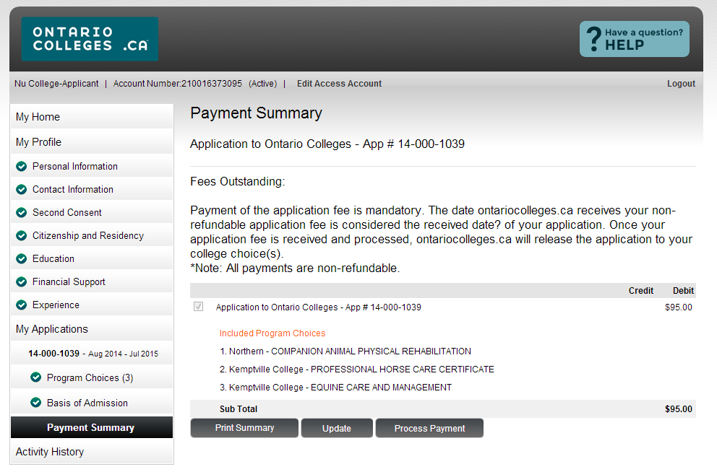
Payment Summary
Review your fees.
Click ‘Process Payment’ to pay your application processing fee.

Slide 29
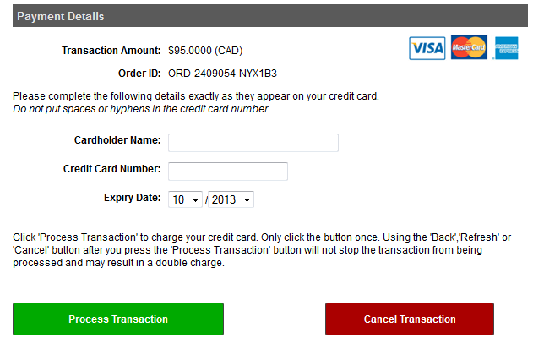
Secure Online Credit Card Payment
Enter your credit card details.
Cardholder Name – must appear exactly as on credit card.
Credit Card Number – Numbers only. No spaces or hyphens.
Expiry Date – Select the dates using the drop down menu.
Click ‘Process Transaction’ to complete your payment.

Slide 30
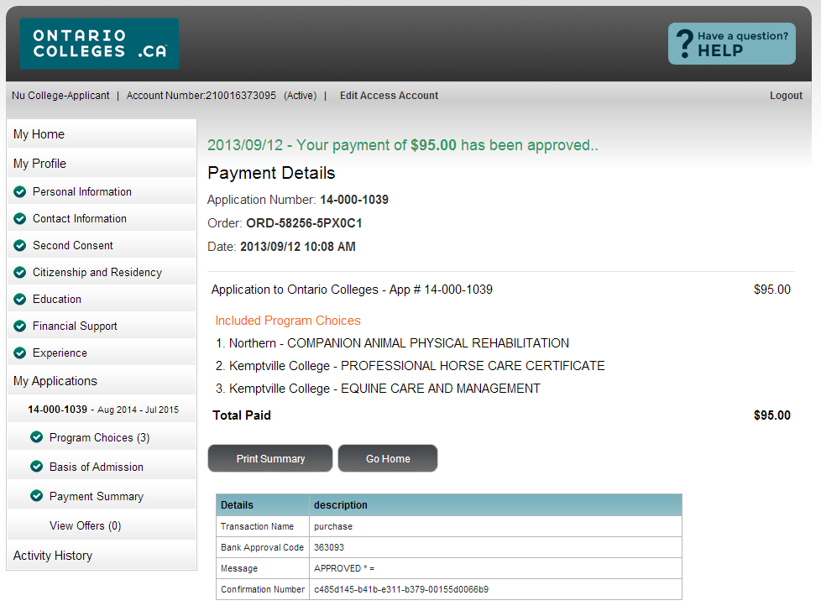
Successful Payment Verification
Payment is verified ‘on screen’ and confirmation is also sent to your email.

Slide 31
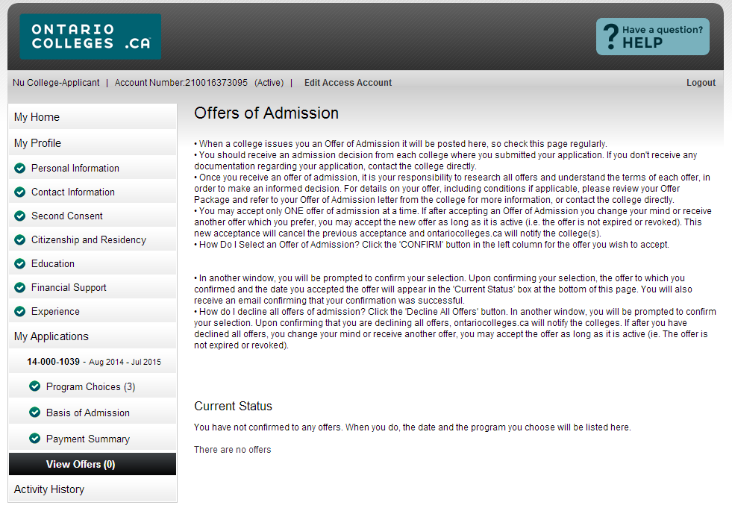
Offers of Admission
OFFERS OF ADMISSION
Offers can only be viewed after they are posted by the colleges.
You may accept only ONE offer at a time.
You may accept only ONE offer in one 24-hour period.
A confirmation of your acceptance is sent to your email.
CHANGING AN ACCEPTED OFFER
If, after accepting an offer, you change your mind or receive another which you prefer, you may accept the new offer (before the expiry date). The new acceptance will cancel your previous one.
Click ‘View Offers’ to view your offers of admission.

Slide 32
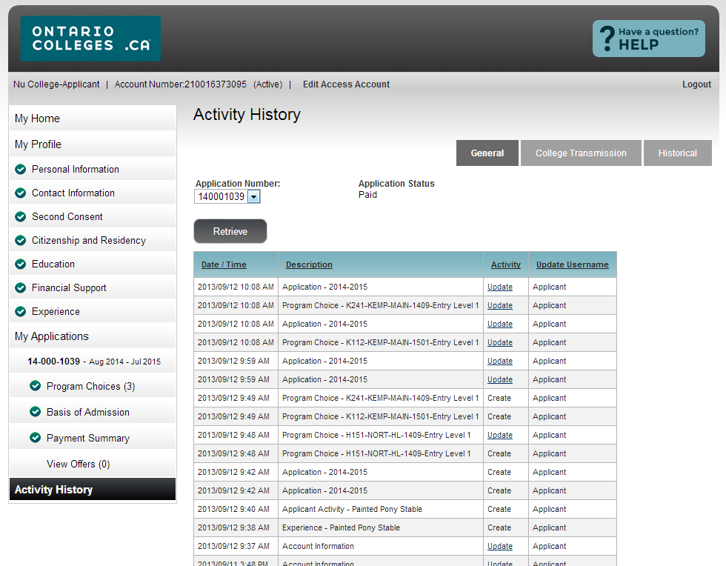
Application Activity History – General Read only

Slide 33
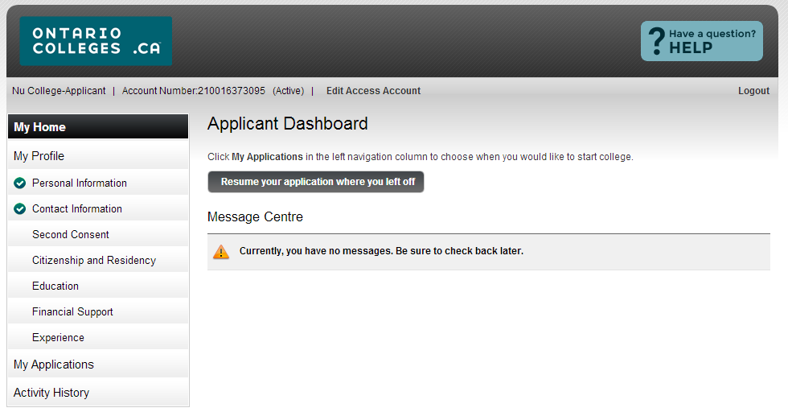
Returning to / Making Changes to Application
Remember to logout when you finish each session.
Clear your computer cache after you logout.
At any time you may resume your application where you left off.
Once ALL sections are completed (as indicated by the green checkmarks), you may return to each section to view or make edits.

