Slide 1
Notes:
Note to principal:
Throughout this presentation the term parent is included. We recognize the diversity of families, and intend this to be a term that includes all who support our children including grandparents, guardians, and caregivers.

Slide 2
Getting to know your child is our priority
Educators observe each child to find their interests, their strengths and their learning needs
Observation and assessment shape the learning program
Educators plan programming to meet each child’s needs based on skills and strategies demonstrated.
Educators communicate with parent in many ways
Notes:
Observation, as well as the documentation of observations, is the most important method for gaining information about a young child as he or she works and interacts in the classroom. The educators observe the child within the program and record what they see and hear in a variety of ways. They may be using an iPad to take a video of a child demonstrating how to build a marble run or they may be creating an audio recording of a child reading aloud, or taking a picture of a piece of artwork. These are all forms of documentation. The documentation informs the educators about your child’s strengths, needs and interests. It assists them in planning their next steps for learning with your child.
Many educators use technology to communicate with parent and caregiver and caregivers. Schools should share information about blogs, twitter accounts, websites etc.

Slide 3
Your child’s day
Full day, every day
Nutritious snack program
Outdoor exploration
Variety of activity levels
Arrival and departure
Transportation
Before and after-school programs (child care)
Notes:
We call the daily schedule in Kindergarten, the “Flow of the Day”. Children attend school all day, every day. We encourage good nutrition in the classroom. Typically children eat twice a day, once in the morning and again in the early afternoon. parent and caregiver and caregivers are encouraged to pack a lunch with a meal (i.e. a sandwich, soup, pasta) and healthy snacks (i.e., cheese and crackers, vegetables and dip, fruit ) and a drink. Many schools have a snack program where healthy snacks are provided to the children during the day. Schools can describe their own snack programs and lunch breaks.
We recognize that learning can occur anywhere. Children are expected to take their learning outside for an extended time, on a daily basis. parent and caregiver and caregivers are encouraged to send their child ready to play outdoors, no matter the weather.
Children are given a variety of opportunities to regulate their energy up, or down throughout the schools day, and a variety of space are available in the classroom to meet each child’s needs.
Schools are to address their current arrival and departure procedures and transportation routines.

Slide 4
The Kindergarten Program
Play based
Child-centred
Developmentally appropriate
Inclusive
Provides a safe and caring environment
Notes:
Play-based inquiry describes the type of learning that occurs in the Kindergarten program. Children learn through their play and exploration in the classroom. The majority of classrooms have a teacher and Early Childhood Educator (ECE). Both educators are enhancing the inquiry in the classroom by modelling skills and strategies, entering into the play with the child, working with small groups, and working one on one with a child. Children in play-based inquiry are given a voice to express their interests and explore them in depth.

Slide 5
Kindergarten viewed through four frames
Belonging and contributing
Self-regulation and well-being
Demonstrating numeracy and literacy behaviours
Problem-solving and innovating
Notes:
Four “frames” are used to structure thinking about learning and assessment that aligns with the way children’s learning naturally occurs and that focuses on aspects of learning that are critical to young children’s development.
Belonging and Contributing
The learning encompassed by this frame also relates to the child’s early development of the attributes and attitudes that inform citizenship, through his or her sense of personal connectedness to various communities.
2. Self-Regulation and Well-Being
What children learn in connection with this frame allows them to focus, to learn, to respect themselves and others, and to promote well-being in themselves and others.
Demonstrating numeracy and literacy behaviours
What children learn in connection with this frame develops their capacity to think critically, to understand and respect many different perspectives, and to process various kinds of information.
Problem-solving and innovating
The learning encompassed by this frame supports collaborative problem solving and bringing innovative ideas to relationships with others.
In connection with this frame, it is important for educators to consider the importance of problem solving in all contexts – not only in the context of mathematics – so that children will develop the habit of applying creative, analytical, and critical thinking skills in all aspects of their lives.
What children learn in connection with all four frames lays the foundation for developing traits and attitudes they will need to become active, contributing, responsible citizens and healthy, engaged individuals who take responsibility for their own and others’ well-being.
Taken from http://www.edu.gov.on.ca/eng/curriculum/elementary/kinderprogram.html

Slide 6
How can you get involved?
Attend our school events
Volunteer
School Council
Attend parent /caregiver/educator conferences
Join an HWDSB advisory committee
Notes:
Personalize to your school – date for meet the teacher
Mention some volunteer examples/opportunities
Invite school council chair to speak
Mention some events at your school
Explain that HWDSB advisory committees seek parent and caregiver and caregiver members if you wish to have a voice at the board level. Details at www.hwdsb.on.ca/board/advisory-committee/

Slide 7
Roles in a school community
Parent/caregiver
Teachers and Early Childhood Educators
Educational Assistants
Learning Resource Teachers (LRT)
Principal
Community Partners
Notes:
Educators recognize that parent and caregiver and caregivers are the first, and most important teachers of their children. parent and caregiver and caregivers offer learning opportunities that are based on the deep knowledge they have of their children. Children’s learning and development occur within the context of their daily lives in families and communities. The classroom educators work together drawing on their strengths in child development, and curriculum to support your child’s learning at school.
An Educational Assistant may be present in the classroom to assist in supporting the learning within the classroom.
A Learning Resource teacher (LRT) may be providing further programming for children in Kindergarten.
Principals are often involved in the inquiry taking place, and enjoy being a co-learner when visiting the Kindergarten classrooms.
There is a strong connection to the community partners like child care, the library, Check it Out Clinics, and parent and caregiver and caregiver and Family Literacy Centres and many more.

Slide 8
The COUNTDOWN to the first day of school!
Visit your family doctor – immunizations
Get a vision test – free eyeglasses in JK year (www.optom.on.ca/OAO/ESEL/AboutESEL.aspx)
Address speech concerns –Early Words (Referrals only possible up to August 31st of a child's first year in kindergarten)
Attend a Check It Out Clinic – developmental
Review the FREE Nipissing District Developmental Screen - www.ndds.caw
Summer – play groups, sleep routines, independent skills
Notes:
Physical wellness plays an important part in a child’s success at school. Scheduling a visit to the family physician prior to the start of school will help ensure that children are healthy and ready to learn.
Eye See Eye Learn – this an initiative that certain ophthalmologists in the city participate in to offer a child’s first pair of eyeglasses free of charge in their JK year. See the website and / or the pamphlet that was in the blue bag for more information.
Confirm with your family doctor that all the immunizations (needles) are up to date.
If you have any concerns about your child’s speech, contact Early Words.
Check It Out Clinics are held in schools and in community centres. These clinics are a gathering of many different professionals like an occupational therapist, speech pathologists, nurse and many more. parent and caregiver and caregivers are encouraged to visit a clinic if they have any concerns about their child’s developmental progress.
parent and caregiver and caregivers are encouraged to get their child ready for school over the summer by:
Explore play group opportunities in your communities
Establish a sleep routine as the start of school approaches
Encourage self-help skills (dressing, meal times, washroom routines)

Slide 9
Aboriginal Self-Identification
By self-identifying, you are helping HWDSB to determine programming and supports for First Nations, Métis, and Inuit student success and achievement.
Notes:
HWDSB’s Policy Directive for Voluntary, Confidential First Nations, Metis, and Inuit child Self-Identification has several added benefits including, but not limited to assisting HWDSB educators to (formally) determine if childs of Aboriginal ancestry are receiving adequate supports to achieve their full potential.
An information brochure and self-identification form are available to all HWDSB childs and their families enrolling or currently registered in the system.
parent, caregivers/guardians are encouraged to return the completed form to the office at the child’s school. School users will collect the self-identification forms and update the entries into Powerschool.
Alternatively, families can complete the child self-identification form online via HWDSB’s website. www.hwdsb.on.ca
HWDSB has an Aboriginal Community Liaison and Aboriginal Social Worker. We offer Mohawk languages at Queen Mary and Prince of Wales schools. We are introducing the support of cultural workers to all of our schools. When parents/guardians/caregivers self-identify a child, this information helps us to determine programs, and also supports our funding from the Ministry of Education so that more opportunities are available for all students to learn about Aboriginal culture, history and traditions.

Slide 10
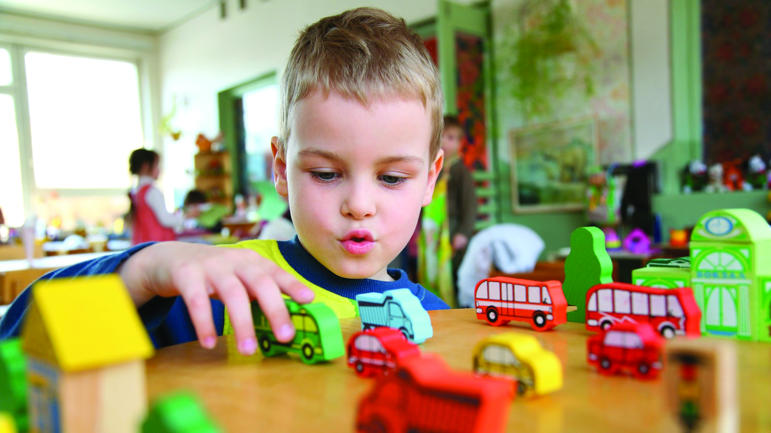
Thank you for joining us!
Enjoy your school tour.

