Slide 1
Choosing Grade 12 Courses
For September 2018

Slide 2
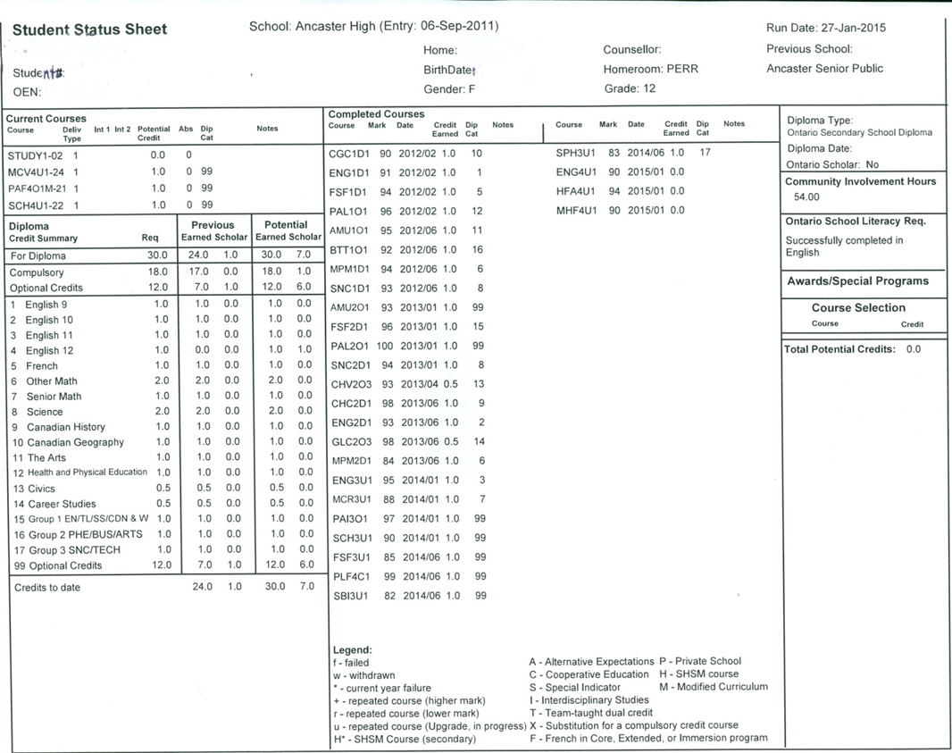
Student Status Sheet
This sheet has ALL the information to know what you have COMPLETED and what you still NEED to graduate.

Slide 3
Make sure you have your own Status Sheet
Make sure you have your sheet!

Slide 4
Check your current courses
Current courses this semester

Slide 5
Compulsory Credit Section you must have 18 compulsories you must have 30 total credits
How many compulsory credits have been earned to date?
ALL compulsories MUST be completed for graduation!
You MUST have 30 credits to graduate!

Slide 6
Completed Courses and Marks
All your completed courses and their marks are in this area

Slide 7
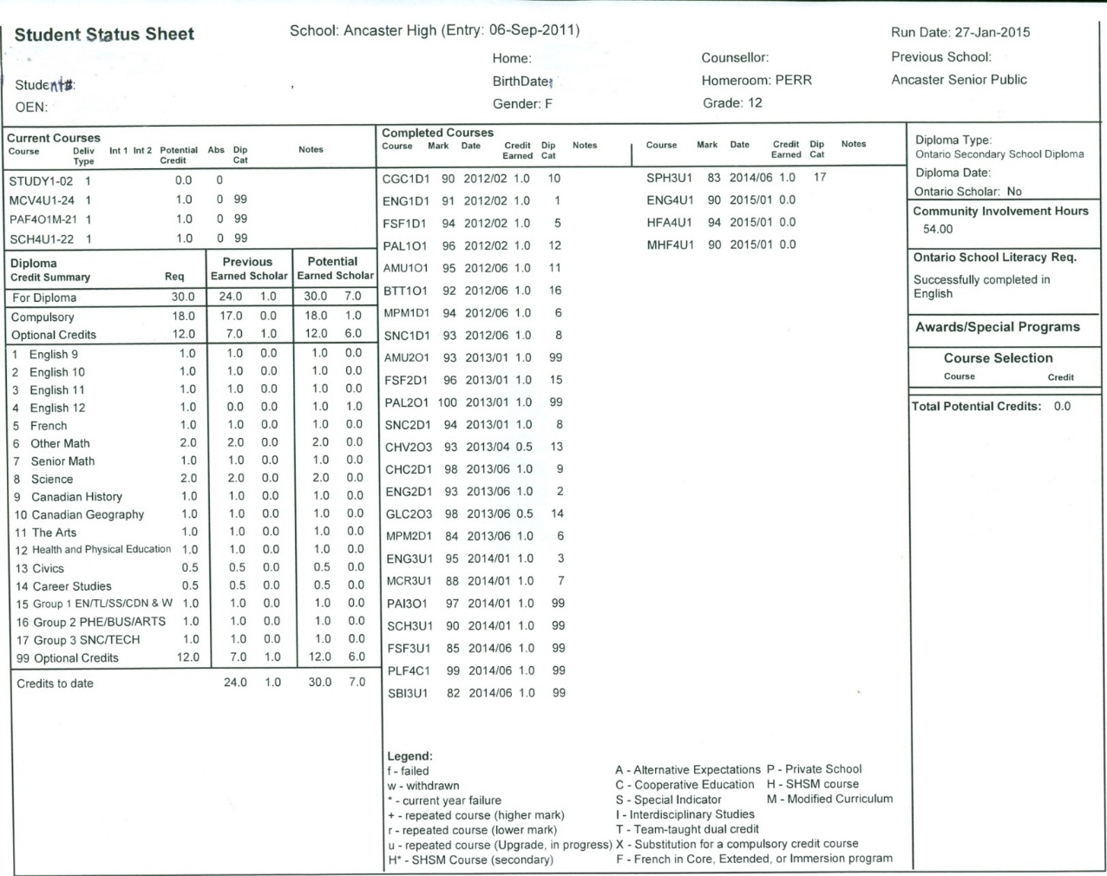
40 Volunteer Hours minimum
Make sure you complete your volunteer hours and your Literacy Test
If you did not pass the OSSLT you can take the OLC4O1 course

Slide 8
Full Disclosure
For all senior level courses only
Any course that is taken beyond 5 days after midterm
These courses will appear on your transcript
Check university policies on repeated courses

Slide 9
Looking Ahead to College or University
What high school courses are needed for my college program?
www.ontariocolleges.ca
What high school courses are needed for my university program?
www.electronicinfo.ca

Slide 10
Destination - University
General University Requirements
6 grade 12 (4U or 4M level) courses
ENG4U1 is required by all universities
Different universities/programs may have different admission requirements

Slide 11
University Application Process
Start researching your university choices NOW.
Students apply to university by late December.
Offers of admission must be accepted by early June
Each university will have its own admissions policies and procedures

Slide 12
University Application Process
We submit ALL your academic information from senior level courses 4 times
September, February, April, June
Early offers of admission may be given from December until March.
Regular/Final offers of admission are given in May (after semester 2 midterm grades are submitted).
Ultimately your admission average will be based on 6 grade 12 U or M courses.
Offers of admission are confirmed in July after your last set of grades are uploaded.

Slide 13
University Application Process
Visit universities at their spring or fall Open Houses
Plan to attend the Ontario Universities Fair in September
Look into any special requirements for your program choices - supplementary applications, auditions, or portfolios
Make sure you will have the required courses for all your potential university options

Slide 14
Destination - College
General College Requirements
Each college has it own program requirements
ENG4C1 (or 4U) is required by all colleges

Slide 15
College Application Process
Students will apply for college by late December.
Offers of admission are given in February and will continue until program spaces are full.
Offers of admission must be accepted by early April.

Slide 16
College Application Process
We submit ALL your academic information 4 times
September, February, April, June
Offers of admission begin in February.
Colleges will use all available course grades in these decisions. - Grade 11 and 12 marks may be used for these offers of admission
Colleges will try to fill ALL programs in February and create waitlists for students who did not receive an offer of admission.
Offers of admission are confirmed in July after your last set of grades are uploaded.

Slide 17
College Application Process
Some programs are HIGHLY competitive, so you may need a higher average/mark than the minimum listed.
Some programs have lots of space available, all you need is the minimum average/mark.

Slide 18
Destination - Apprenticeship
General Apprenticeship Requirements
You MUST have an OSSD
You may need job experience to secure an apprenticeship
Co-op can lead to OYAP or Dual Credit opportunities at college

Slide 19
2018-2019 Option Sheet

Slide 20
Instructions for selecting courses

Slide 21
What Options MUST I Choose?
Any remaining compulsory courses for graduation
Double check your group 1, 2, or 3 credits
1 Grade 12 Compulsory Course
English ENG4U1(university) or ENG4C1(college), or ENG4E1(Workplace)
Plus enough electives to graduate
You MUST take a minimum or 3 courses EACH semester

Slide 22
What are the group 1,2,3 courses?
Group 1
Additional English course
Additional French course
Any other Language course (Spanish, German, Latin)
Any Social Science course
Any Canadian and World Studies course
Any Humanities course
Any Guidance Course
Co-op

Slide 23
What are the group 1,2,3 courses?
Group 2
Additional ARTS course (visual, drama, music)
Additional Physical Education course
Additional French course
Any Business course
Co-op

Slide 24
What are the group 1,2,3 courses?
Group 3
Additional Science course from grade 11 or 12
Additional French course
Any Technology course
Any Computer Studies/Computer Science course
Co-op

Slide 25
What are my elective course choices?
Go to your Option Sheet – long white sheet
Courses are listed by grade level and subject area
Make sure you have the prerequisite for any grade 12 courses you select
Remember that co-op counts for 2 credits

Slide 26
Elective course prerequisites
You MUST have the grade 11 Tech course to take the grade 12 Tech course
(ex. TGJ3M1 for TGJ4M1)
You MUST have the grade 11 ARTS course from the same area to take that course in grade 12
(ex. AVI3M1 for AVI4M1 or ADA3M1 for ADA4M1)
For MOST Social Science and Humanities courses – the prerequisite can simply be ENG3U1 , or a grade 11 U or M social science course

Slide 27
Information for Grade 12 Courses
Check the course descriptions and flowcharts in the School Course Calendar (online)
Talk to your subject teachers about what courses are offered in their departments at the next level
Talk to your Guidance Counsellor

Slide 28
Math Curriculum
Pay close attention to which course you select
Make sure you have the prerequisite course you need and are on the right pathway to support your future goals

Slide 29
Math Pathways Chart

Slide 30
Selecting Math Courses
University Programs that require specific math courses
Students pursuing
Engineering
Computer Science
Mathematics
most Science programs
most Business programs
most Architecture programs
MHF4U
and/or
MCV4U or MDM4U
in Grade 12
These require

Slide 31
Selecting Math Courses
Some University Programs require any 4U math
Students pursuing
Nursing (some)
Teaching (primary)
Some Kinesiology/Phys Ed
A few Business programs
MDM4U1
would be acceptable
These require

Slide 32
Selecting Math Courses
For college programs that require a math course, some prefer or require MCT4C1for require Grade 12 Math
Students pursuing
Technology
Engineering Technology
Computer Science
Some Health Sciences
These require or recommend
MCT4C1

Slide 33
Selecting Math Courses
Some college programs require ANY grade 12 C or U math course – so MAP4C1 would be fine
Students pursuing
Business
Some technology programs
Some health related diplomas
MAP4C1
Would be acceptable
These require

Slide 34
Selecting Math courses
Apprenticeships
You can take any level of math
If you are going into a math dependent trade, then the higher the level of math, the better for your Apprenticeship
Workplace
You can take any level of math

Slide 35
Online Courses
This year, students have the option of taking some courses online.
On the options sheets these will have “@” or “#”
Online courses are organized just like “in school” courses
There are set timelines
There are set due dates
Units will begin and end
There will be a culminating activity AND/OR an exam
Online courses are NOT self paced!

Slide 36
SHSM – Aviation and Aerospace
If you are registered in SHSM, make sure you complete your requirements
Students must meet the following criteria by the time they graduate to achieve this designation:
4 major credits
1 math
1 English
1 other
2 co-op credits

Slide 37
SHSM – Aviation and Aerospace
Grade 12s must complete
2 major credits from the following
TTL4C1 – Aviation
TTJ4C1 – Transportation
TMJ4C1 – Manufacturing
TDJ4M1 – Tech Design
SPH4U1 – Physics
Make sure your “other” credit is complete
Make sure you complete your coop requirement
Make sure your certificate training is completed by the end of grade 12

Slide 38
SHSM – ICT
Grade 12s must complete
2 major credits from the following
Make sure your “other” credit is complete
Make sure you complete your coop requirement
Make sure your certificate training is completed by the end of grade 12

Slide 39
Dual Credit
A chance to simultaneously earn both a college credit and a high school credit
• An opportunity to experience college level programming while still in high school
• The opportunity to work towards completing their Ontario Secondary School Diploma
• An experience that will help them make a successful transition to college

Slide 40
OYAP
Areas of study include:
Auto Service Technician
Carpentry
Child and Youth Worker
Cook
Hairstyling
Truck and Coach Technician

Slide 41
Special Coop
Centralized placements
City of Hamilton, Hamilton Police Services, Hamilton Health Sciences, Sheraton Hotel, St. Joseph’s Healthcare …….
Competitive coop opportunities through HWDSB (all day programs):
ArtSmart/Musical Theatre
Canadian Armed Forces Military Coop
Building Careers from the Ground Up
Limeridge Mall
Healthcare Support

Slide 42
Entering your options!
This year you will be entering your option choices at HOME into Career Cruising.
You will follow the instructions on your “Career Cruising Instruction Sheet”.
You MUST select a minimum of 3 courses for each semester, use “study” periods if you want a spare as part of your timetable.

Slide 43
Getting Courses Into Career Cruising
Each student has an instruction sheet on entering courses into Career Cruising.
Students will log in to Career Cruising through “The Hub”.

Slide 44
Paying School Fees
All school fees are to be paid by “School Cash Online”
There is a help number on the information sheet – if you need log in information, the main office has that information
School fees: $20.00
Yearbook pre-ordered: $40.00
If you are unable to pay online, please bring a cheque made payable to “Ancaster High School”

Slide 45
When is all this due?
Option Sheets are due back to Student Services March 2, 2018.
Payment of School Fees - due by March 2, 2018.
Courses into Career Cruising – completed by March 2, 2018.

Slide 46
Summer School Courses
Students interested in Summer School Courses MUST make an appointment with their Guidance Counsellor in MAY.
Even if the plan is to take a course in summer school, make it one of your option choices until you actually register for summer school
Summer school runs:
ALL courses (except careers and civics) – in school and online – the month of July, 4 weeks
There are NO booklet courses offered through Summer School.
NOTE: Some universities are requesting that required courses are taken during through “regular day school” – example Waterloo University Mathematics Faculty

Slide 47
Thinking of Returning? - Post-grad
Students may return for 1 semester
Students MUST select a minimum of 3 courses (you can apply to go part time in September if you are a graduate)
Any student wishing to return for semester 2 will apply in January
If you are thinking of a post-grad semester – have a plan!

Slide 48
Questions?
Remember we are here to help you.
If you have any questions, please contact Student Services at Ancaster High and we will support you.
Use the Ancaster High School – Student Services website for information.
http://www.hwdsb.on.ca/ancasterhigh/student-services/

